Slide 1
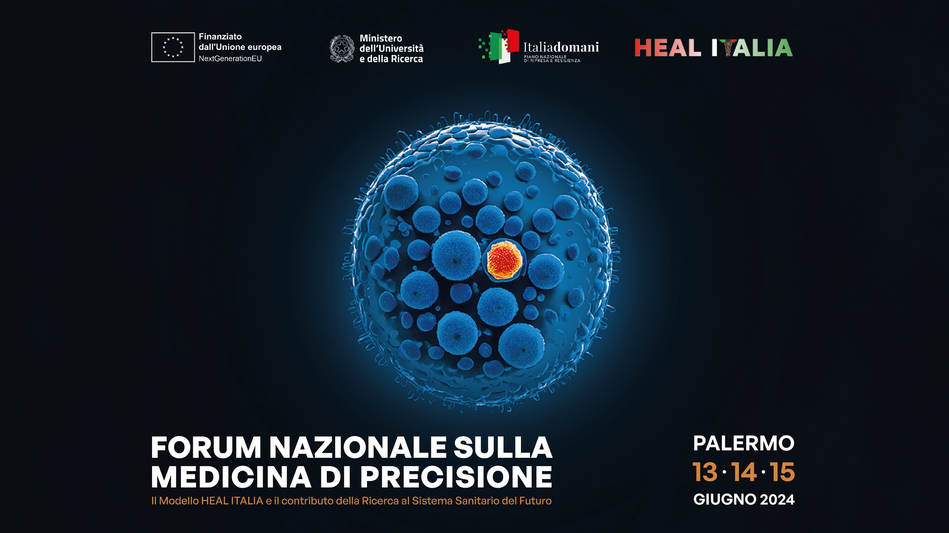
Notes:
08

Slide 2

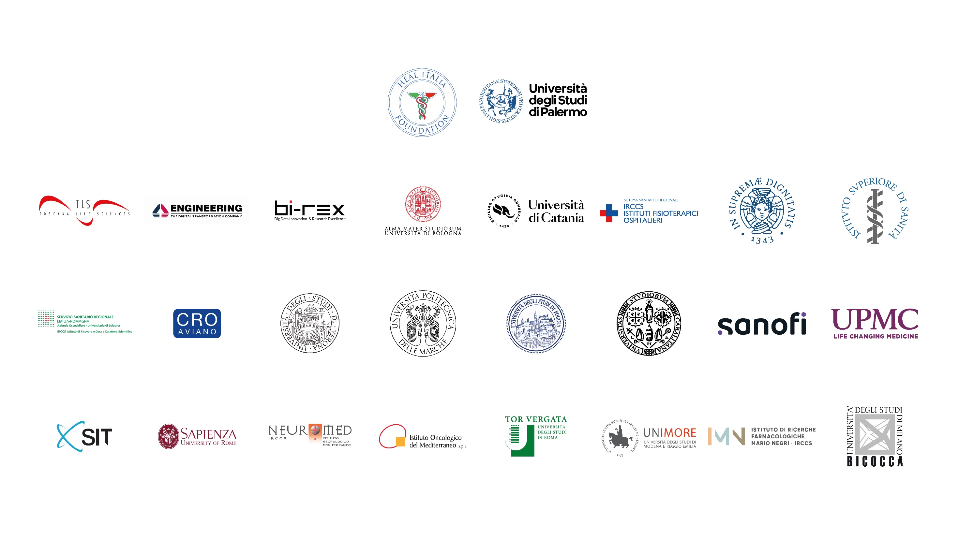





SPOKE 6
Healthy Toolbox
PRESENTATION OF THE SPOKE
40 researchers involved
19 RTD-A
5 Research fellows
4 PhD students
Spoke Leader: UniMore
Affiliates: CRO/UniBO/UniCA/UniCT/UniFG/UniMIB/UniPA/UniPI/UniVR
Managers: Carlo Bortolotti (Physical Chemist), Massimo Dominici (Oncologist)

Slide 3
SPOKE 6
Healthy Toolbox
PURPOSE OF THE SPOKE
Development of innovative devices for applications in precision diagnostics and therapy
→ Areas of intervention
Oncology
Rare diseases
Metabolic Diseases
Liver and Kidney Diseases
Regenerative Medicine and Materials (wounds, odonto)
Notes:
broad definition of “devices” in the Heal Italia project encompasses from molecular systems to (bio)materili, miniaturizable diagnostic assays and from robotic systems to hardware solutions.

Slide 4


SPOKE 6
Healthy Toolbox
Optical and electronic sensors for the detection of electrophysiological signals, cellular microenvironment, nucleic acids, proteins, extracellular vesicles, fetal cells
Nanotechnology modeling, synthesis, chemical-physical characterization, in vitro and in some cases in vivo of drug delivery systems and nanotheranostics
Biomaterials for prevention of wound infections and tissue regeneration
In silico and in vitro models (3D scaffold)
Hardware + algorithms for precision surgery
Genomics Evaluation of prognostic and predictive biomarkers of response/resistance to treatments
WHERE WE ARE
41 pre-clinical studies
started
9 pre-clinical studies concluded
5 clinical trials started
35 publications
in international journals

Slide 5


SPOKE 6
Healthy Toolbox
WHERE WE ARE GOING
Optimization of devices under development, initial phases of laboratory validation, increase in statistics, clinical studies
Strengthening interactions with other Spokes: @Spoke 2 for robotic surgery software, @Spoke 4 for EV detection or identification of new biomarkers, @Spoke 5 for identification of targets that require ad hoc delivery systems

Slide 6
SPOKE 6
Healthy Toolbox
THE CHALLENGE
Set of diagnostic and therapeutic devices validated in the laboratory with biological fluids (biosensors) or in cellular and animal models (bio- and nano-materials)
Precision surgery and its algorithms that can be implemented on a large scale
3D models with complexity comparable to healthy and pathological tissues: «the concept of tissue avatar»
The regulatory context and clinical applications

Slide 7


SPOKE 6
Healthy Toolbox
FORECASTS AFTER THE CLOSURE OF THE PROJECT
Supply chain: Design and modeling, manufacturing, characterization and optimization with pre-clinical and clinical validations
Creation of a national network of expertise in the field of device development for precision medicine
Collaborations / Workshops with certification bodies: TUV, AIFA, ISS, CNT
Partnership with the business world, starting from the well-known biomedical district of Modena
Start-ups
European partnership for the creation of coherent EU consortia
Training in Master's Degree courses

