Slide 1


Slide 2
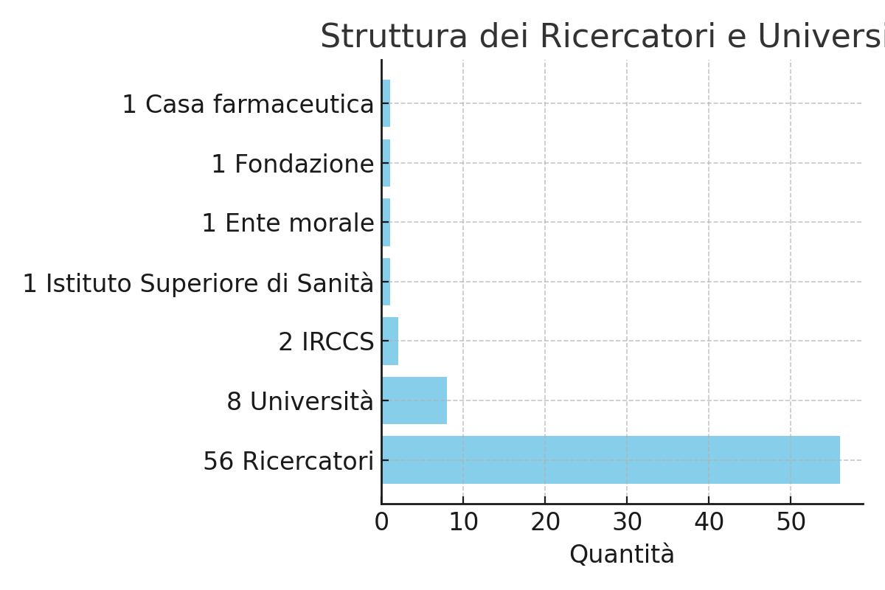
















SPOKE 5: Next-gen Therapeutics
SPOKE PRESENTATION
56 researchers involved: 40 PIs, 8 newly recruited RTD-A, 2 newly recruited ARs, 3 newly recruited PhD students (+ 3 Fellows and 1 PhD)
9

Slide 3
SPOKE 5: Next-gen Therapeutics
From silico to bedside” design and validation of innovative tailored and personalized therapeutic strategies
UNIPA, UNIMIB
UNIMIB, CRO, TLS, UniRoma1, UNIMORE, UNIPA, UNICA, UNIVR
AIM: To develop successful therapeutic strategies for genetic diseases due to non-sense mutations or mutations causing functional defects
AIM: To generate tools for the selective killing or control of pathogenic cells with high treatment efficacy, containing side effects and reduce the time of therapy administration
UNIMIB, UNIBO, UNICT, UNIMORE,
UNIFIG, SANOFI, Neuromed
AIM: To identify innovative microbiota modulating therapies tailored on the individual patient’s microbial dysbiosis.
SAPIENZA, UNIMORE, IFO, ISS, UNIBO, UNIMIB, UNIROMA1, M. NEGRI
AIM: To optimize a pipeline for the identification of novel candidate drugs and testing of available drugs for human diseases, using modeling tools and AI.

Slide 4
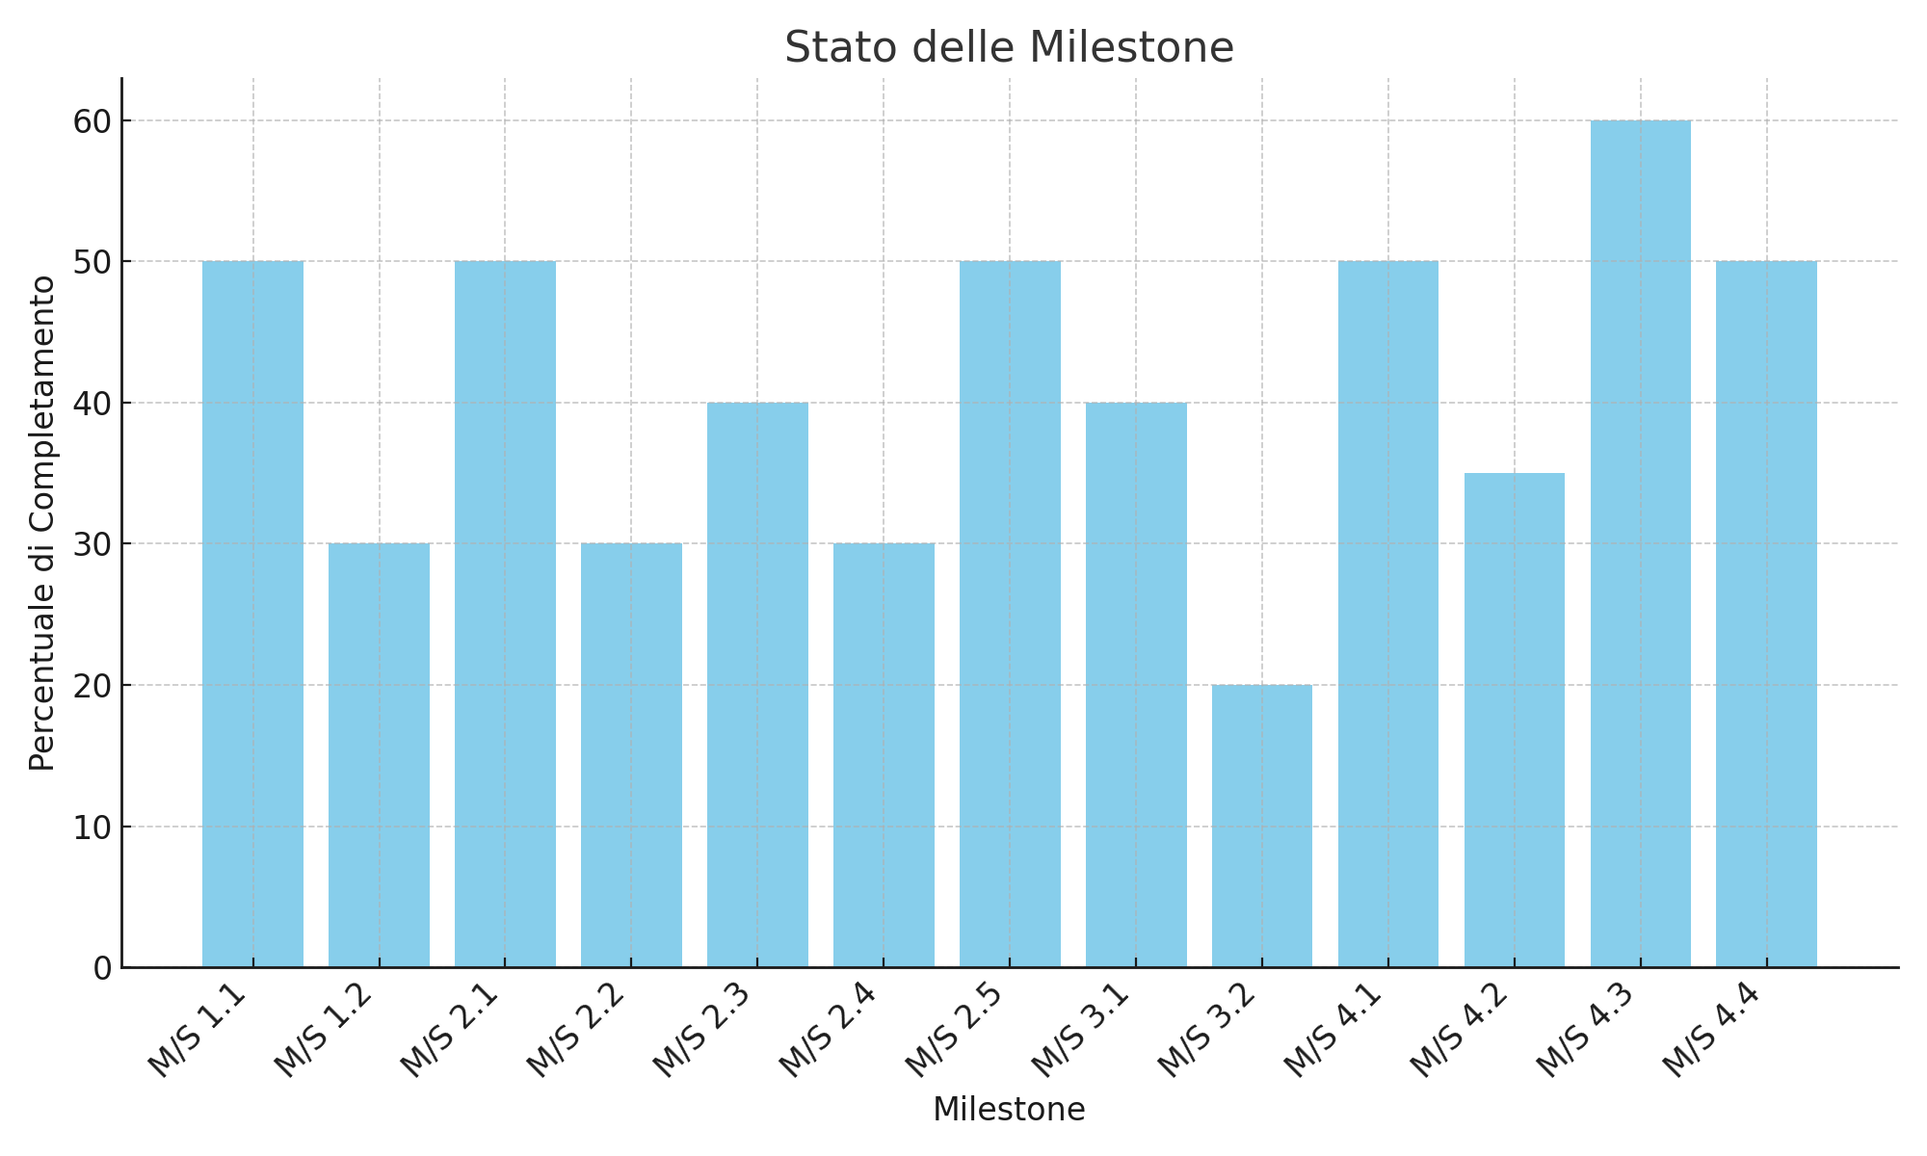
SPOKE 5
Next-gen Therapeutics
Milestones % of achievement
WHERE WE ARE

Slide 5
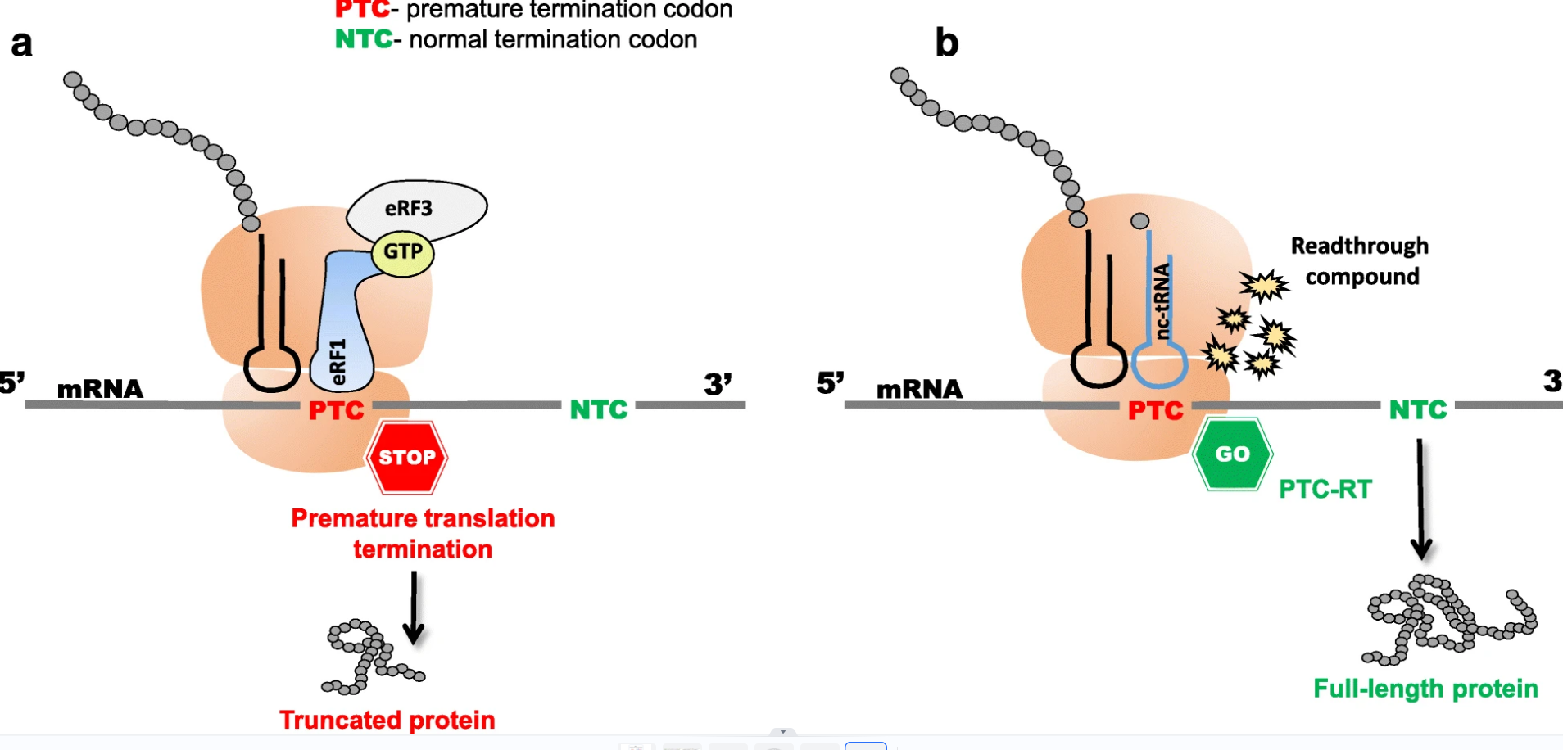
SPOKE 5
Next-gen Therapeutics
WHERE WE ARE GOING
WP1: Genetic Diseases
New TRIDs identified for the restoration of CTFR expression the in a new mouse model of Cystic Fibrosis

Slide 6
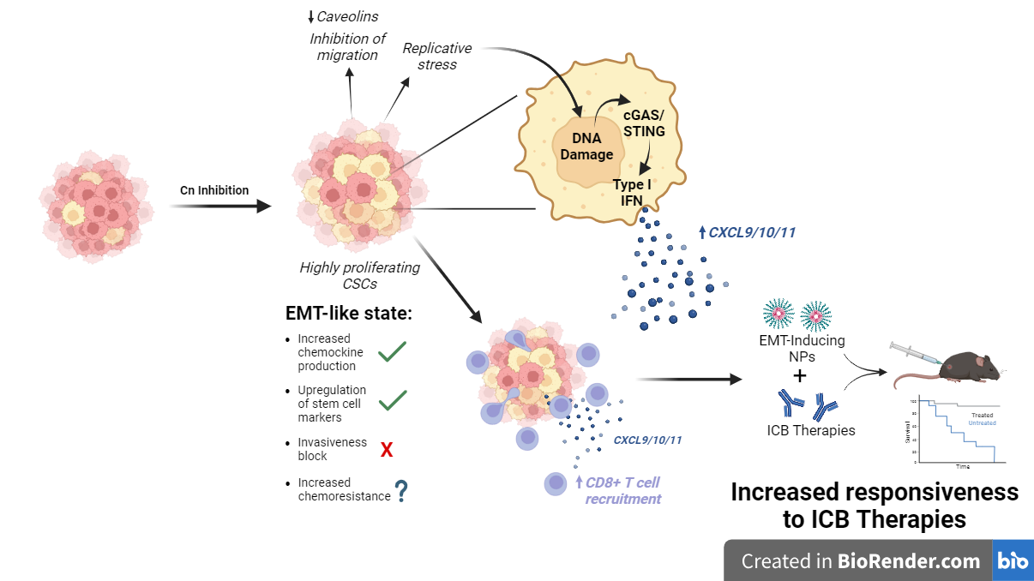
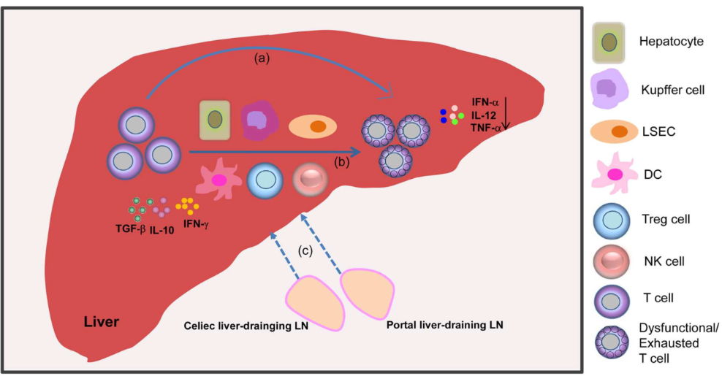
SPOKE 5
Next-gen Therapeutics
WHERE WE ARE GOING
Antigen transfer to the liver to induce tolerance
Nanoparticles
collaboration spoke 6
WP2: Tumors, autoimmune diseases
Metabolism:
reduce adenosine generation in the TME
GPC1, GPC3, GD2 and CD138 to target GBM, PDAC; HCC and MM
Ab chimeric collaboration spoke 8
T cell
CAR-T or Bi-specifics CAR-T
Tumors
Autoimmune diseases

Slide 7
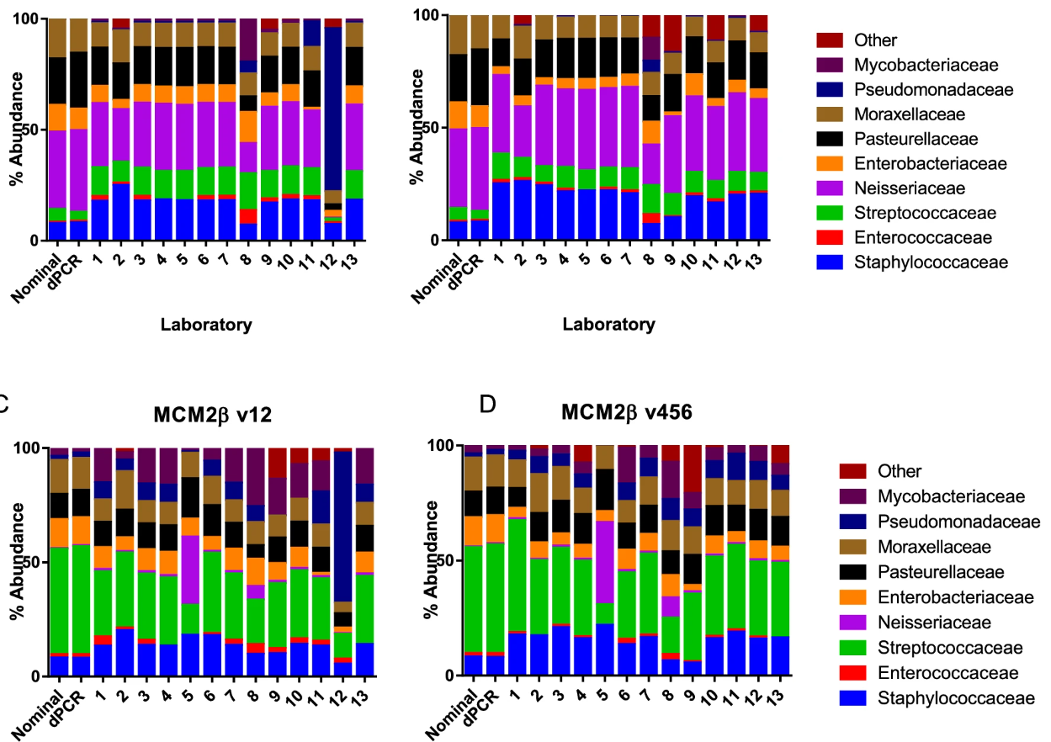
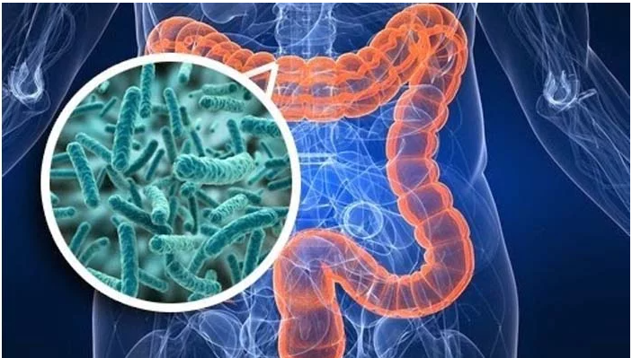
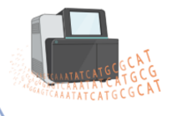
SPOKE 5
Next-gen Therapeutics
WHERE WE ARE GOING
WP3 : Microbiota, dysbiosis
Characterization of the microbiota in different dysbiosis conditions, correlation with disease and response to therapy

Slide 8
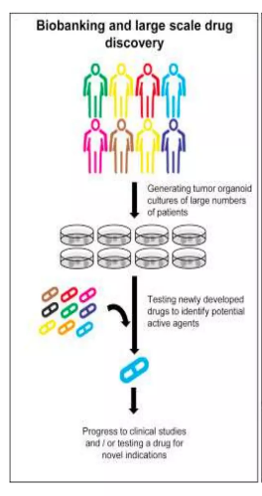
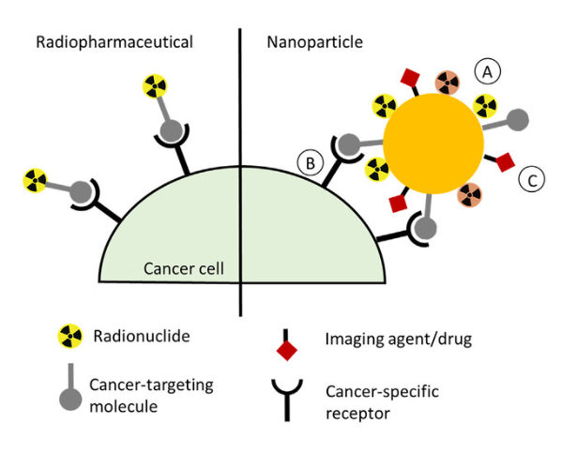
SPOKE 5
Next-gen Therapeutics
WHERE WE ARE GOING
WP4: Drug reporposing per PID, NAFLD/NASH; new radiopharmaceuticals
Generation and Screening of Biobanks (PID and NAFLD/NASH)
Screening of existing biobanks
Collaboration
with spoke 1, 2,3
Drug repositioning
Drug repurposing
Radiopharmaceuticals against tumors

Slide 9
SPOKE 5
Next-gen Therapeutics
THE CHALLENGE
Where we will be in month 36
WP1: new molecules correcting premature translation termination and protein misfolding
WP2: new biological drugs and nanodrugs for the treatment of tumors and autoimmune diseases; definition of metabolic pathways on which to intervene pharmacologically to obtain immunonomodulatory activity
WP3: Identification of dysbiosis conditions that influence anti-tumor therapies; of microbiota components with immunomodulatory effect; of microbiota components negatively modulated by chronic drug use
WP4: new molecules identified in silico for the regeneration of cadiomyocytes and for use as anticancer agents; of new radiolabeled drugs for anti-tumor therapy; «repurposed drugs» for the therapy of NASH/NAFLD or rare PID diseases with gastrointestinal involvement
Notes:
Validazione di ADC, BiTEs, anticorpi monoclonali chimerici ricombinanti, nanoparticelle, cellule CAR-T e di vie metaboliche su cui intervenire farmacologicamente per ottenere un effetto immunomodulatore

Slide 10
SPOKE 5
Next-gen Therapeutics
FORECASTS AFTER THE CLOSURE OF THE PROJECT
Search for Financing : Garantire la continuità delle attività di ricerca e sviluppo.
Collaborations and Partnerships : New collaborations with research bodies, universities and pharmaceutical companies to exploit synergies and accelerate the implementation of therapies.
Commercialization and Technology Transfer : Transfer the technologies developed from the laboratory to the market.
Development of Future Research Lines : Identify and develop new lines of research based on discoveries made during the project.
Formazione : Train the next generation of researchers and specialists in the field of innovative therapies.

Slide 11


