Slide 1


Slide 2




SPOKE 4
Precision Diagnostics
Università di Milano Bicocca
Università di Verona
Università di Modena e Reggio Emilia
SPOKE PRESENTATION
Università di Bologna / Sant’Orsola
Università di Pisa
Università delle Marche
54 researchers (64)
Sapienza Università di Roma
Università di Tor Vergata
Università di Foggia
13 affiliated entities
Università di Cagliari
Università di Palermo
Università di Catania
In collabortion with Spoke 2, Spoke 6 and Spoke 8

Slide 3











2
3
SPOKE 4
1
4
Spoke Purpose
8
5
Create new diagnostic pathways in order to obtain a diagnosis:
7
6
Rapid
Fast
Precise
Accessible
Cost-effective

Slide 4







2
3
SPOKE 4
1
4
In wich pathologies?
8
5
7
6
Rare
Oncological
Cardiovascular
Metabolic

Slide 5


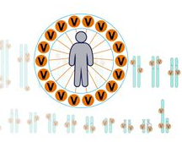


WP 1
New early and non-invasive markers
WP 2
New tools for advanced biological diagnosis of complex and oncological pathologies
2
3
WP 3
New solutions for digital image acquisition and interpretation
1
4
8
5
7
6
WP 4
Network-based frontier in the management of polygenic and tumor pathologies

Slide 6






SPOKE 4
Precision Diagnostics
Where are we?
9 Preclinical
52 Original
studies
43 Clinical
35 Publications
In indexed, open access, high impact journals

Slide 7
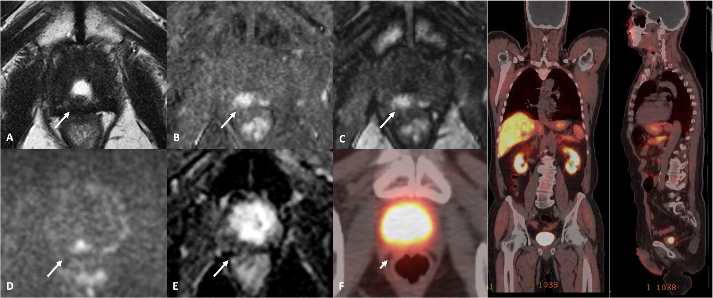
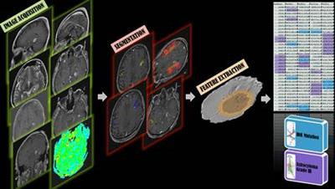

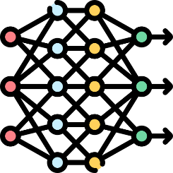

SPOKE 4
Precision Diagnostics
Where are we going?
The first examples of practical application of precision diagnostics
New frontiers of MRI imaging
Faster, cheaper and more effective prostate cancer screening and follow-up
Bi-parametric MRI of the prostate without contrast medium
In collaboration with Spoke 8
Nuovi algoritmi basati IA per guidare la biopsia prostatica
Magnetic Resonance Imaging
Artificial intelligence
New scores (PI-RR), to identify tumor recurrence early via MRI without having to resort to PET/CT (more invasive).
400 patients

Slide 8
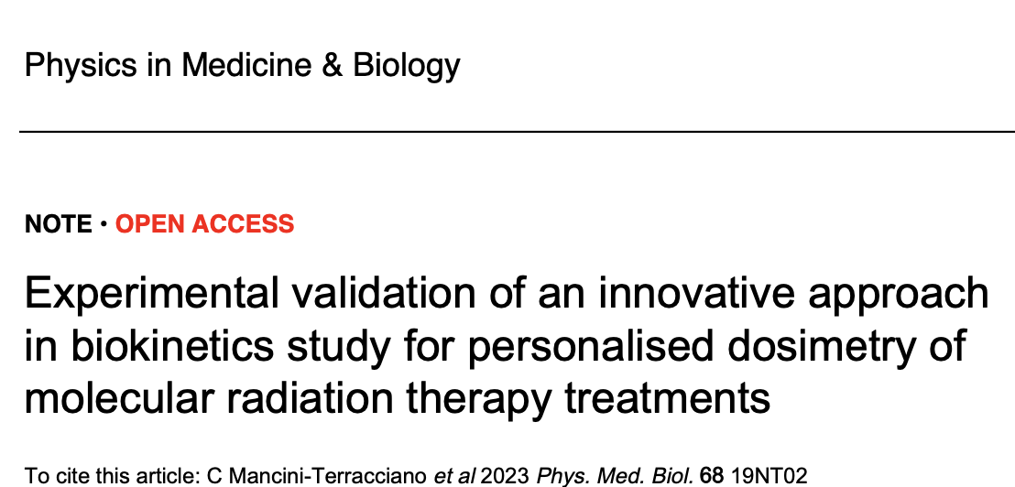
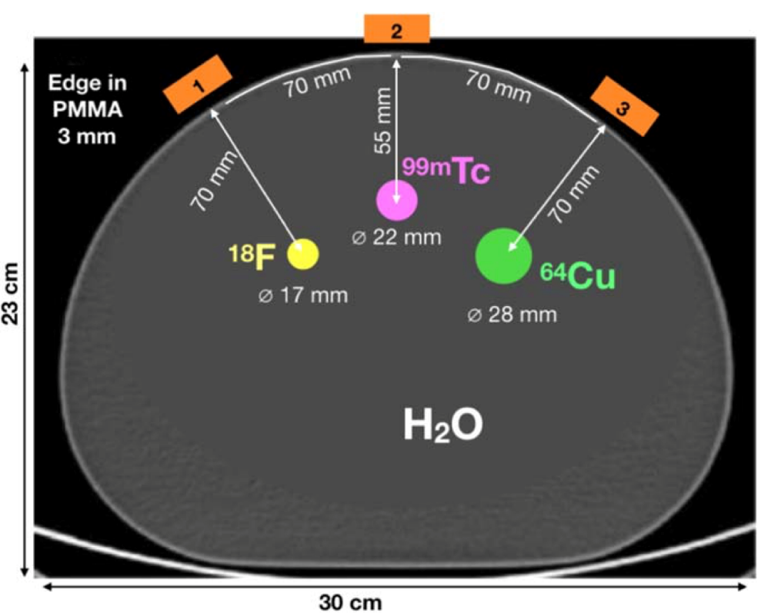
SPOKE 4
Precision Diagnostics
Where are we going?
The first examples of practical application of precision diagnostics
Innovations in Nuclear Medicine
Personalization of molecular radiotherapy treatment with a wearable meter of absorbed radiation dose (internal dosimetry)

Slide 9
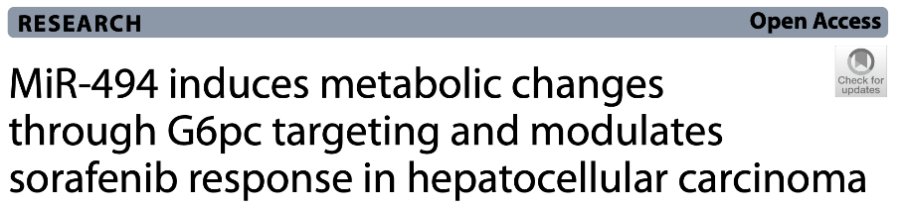

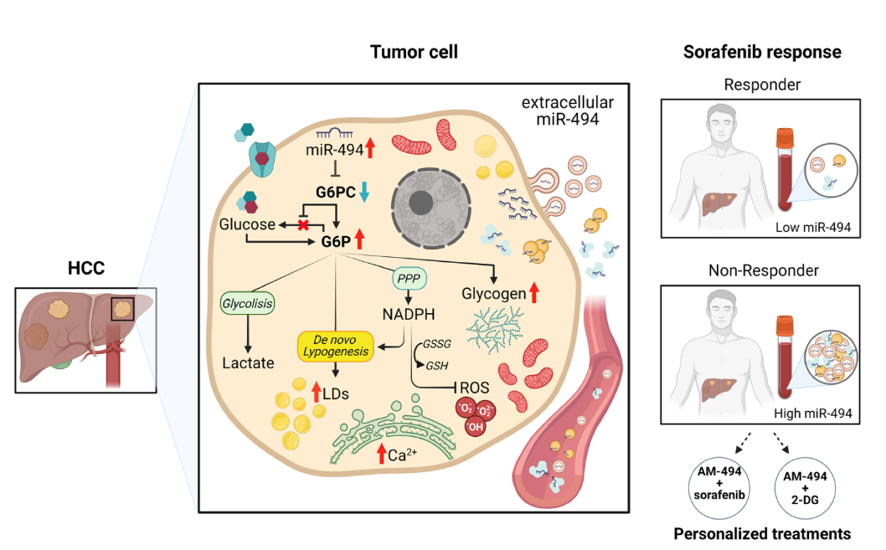

SPOKE 4
Precision Diagnostics
Where are we going?
The first examples of practical application of precision diagnostics
Molecular biology as a tool for personalized medicine
Micro-RNA 494 has demonstrated a crucial role in metabolic reprogramming in hepatocellular carcinoma cells
Potential roles:
Biomarker of response to sorafenib therapy
Therapeutic target for combined strategies with sorafenib or other oncology drugs

Slide 10
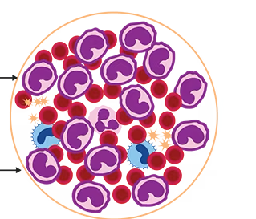
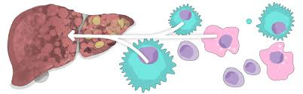

SPOKE 4
Precision Diagnostics
The challenge
From the laboratory to clinical practice
Applying AI to clinical practice
In estimating cardiovascular risk to optimize the indication for the implantation of implantable cardiac defibrillators
In hematological tumors → for better stratification and prognosis
In collaboration with Spoke 2
300 patients
In obtaining a dimensional reduction of genomic data in complex pathologies → personalized diagnosis
In autoimmune liver diseases → differential diagnosis between primary biliary cirrhosis and autoimmune hepatitis
40 patients

Slide 11
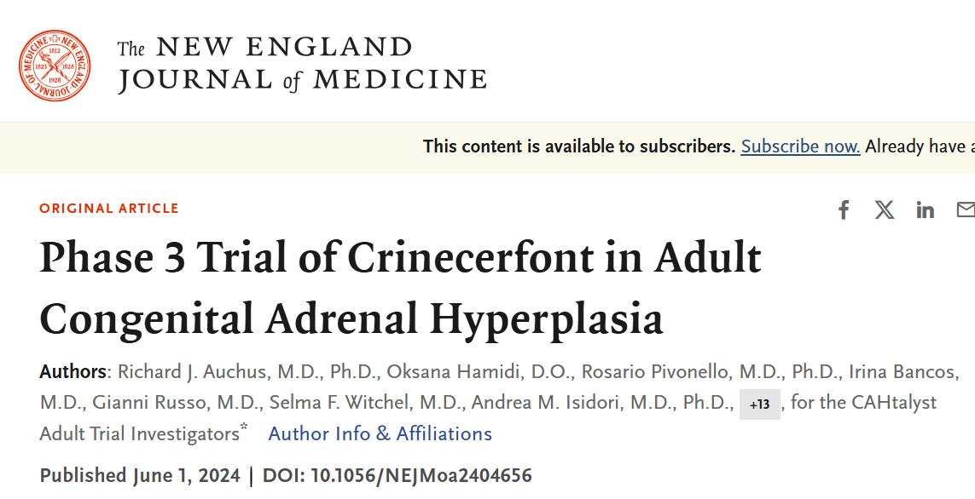
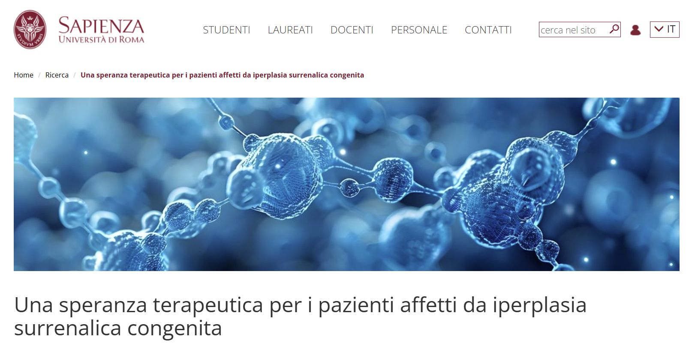
SPOKE 4
Precision Diagnostics
The challenge
From the laboratory to clinical practice
Nelle malattie Rare
Andrea M. Isidori, M.D., Ph.D., et al.

Slide 12
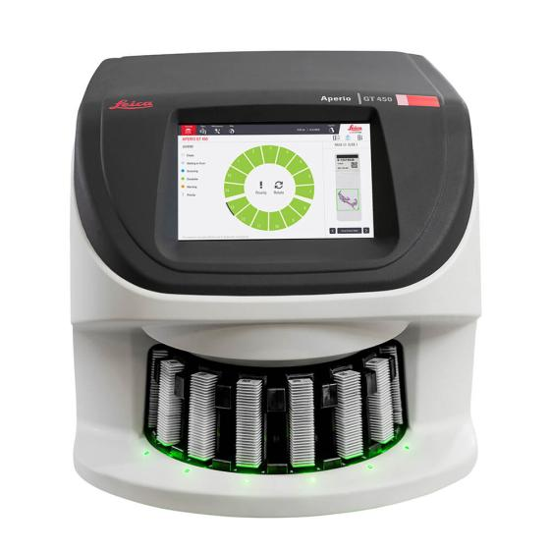
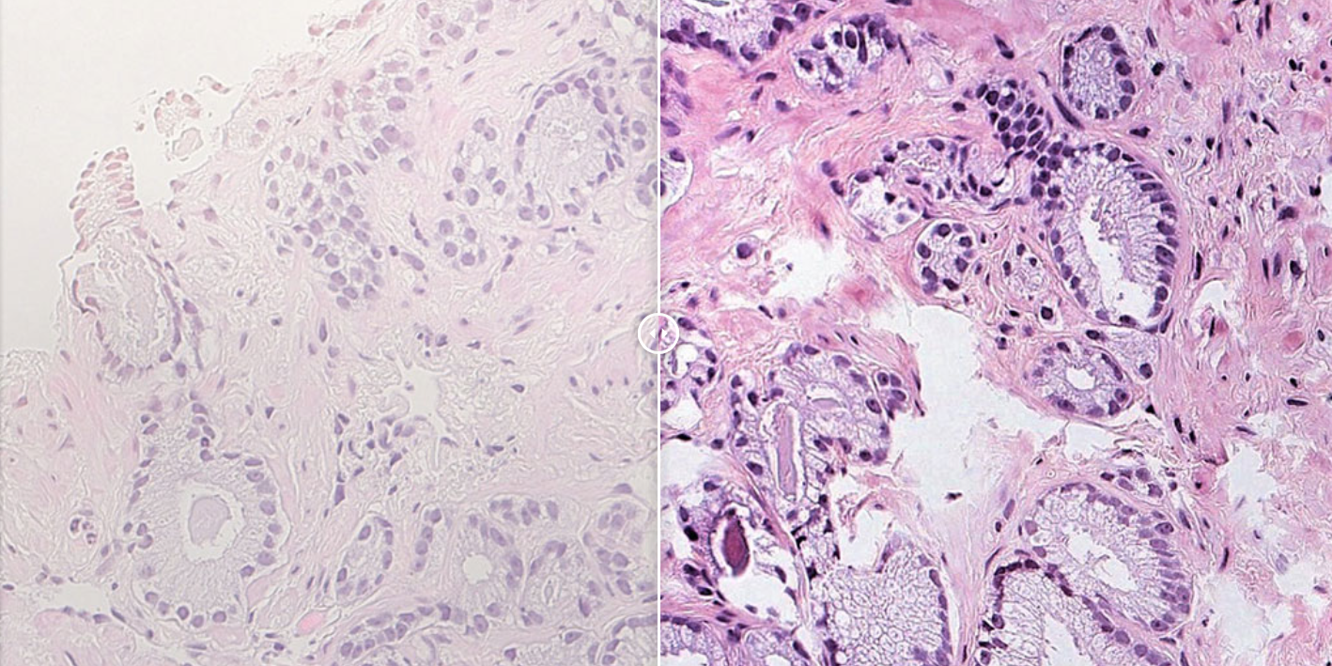
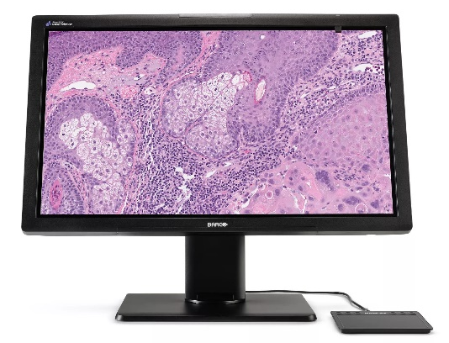
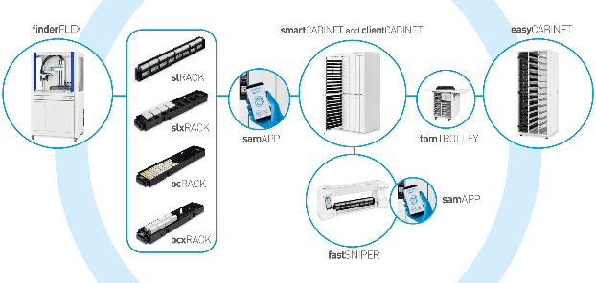

Standardization system AI-assisted
SPOKE 4
Precision Diagnostics
The challenge
From the laboratory to clinical practice
Create a digital pathology infrastructure
New latest generation
scanner
Standardization system
AI-assisted
New WorkStation
Automated filing system

Slide 13



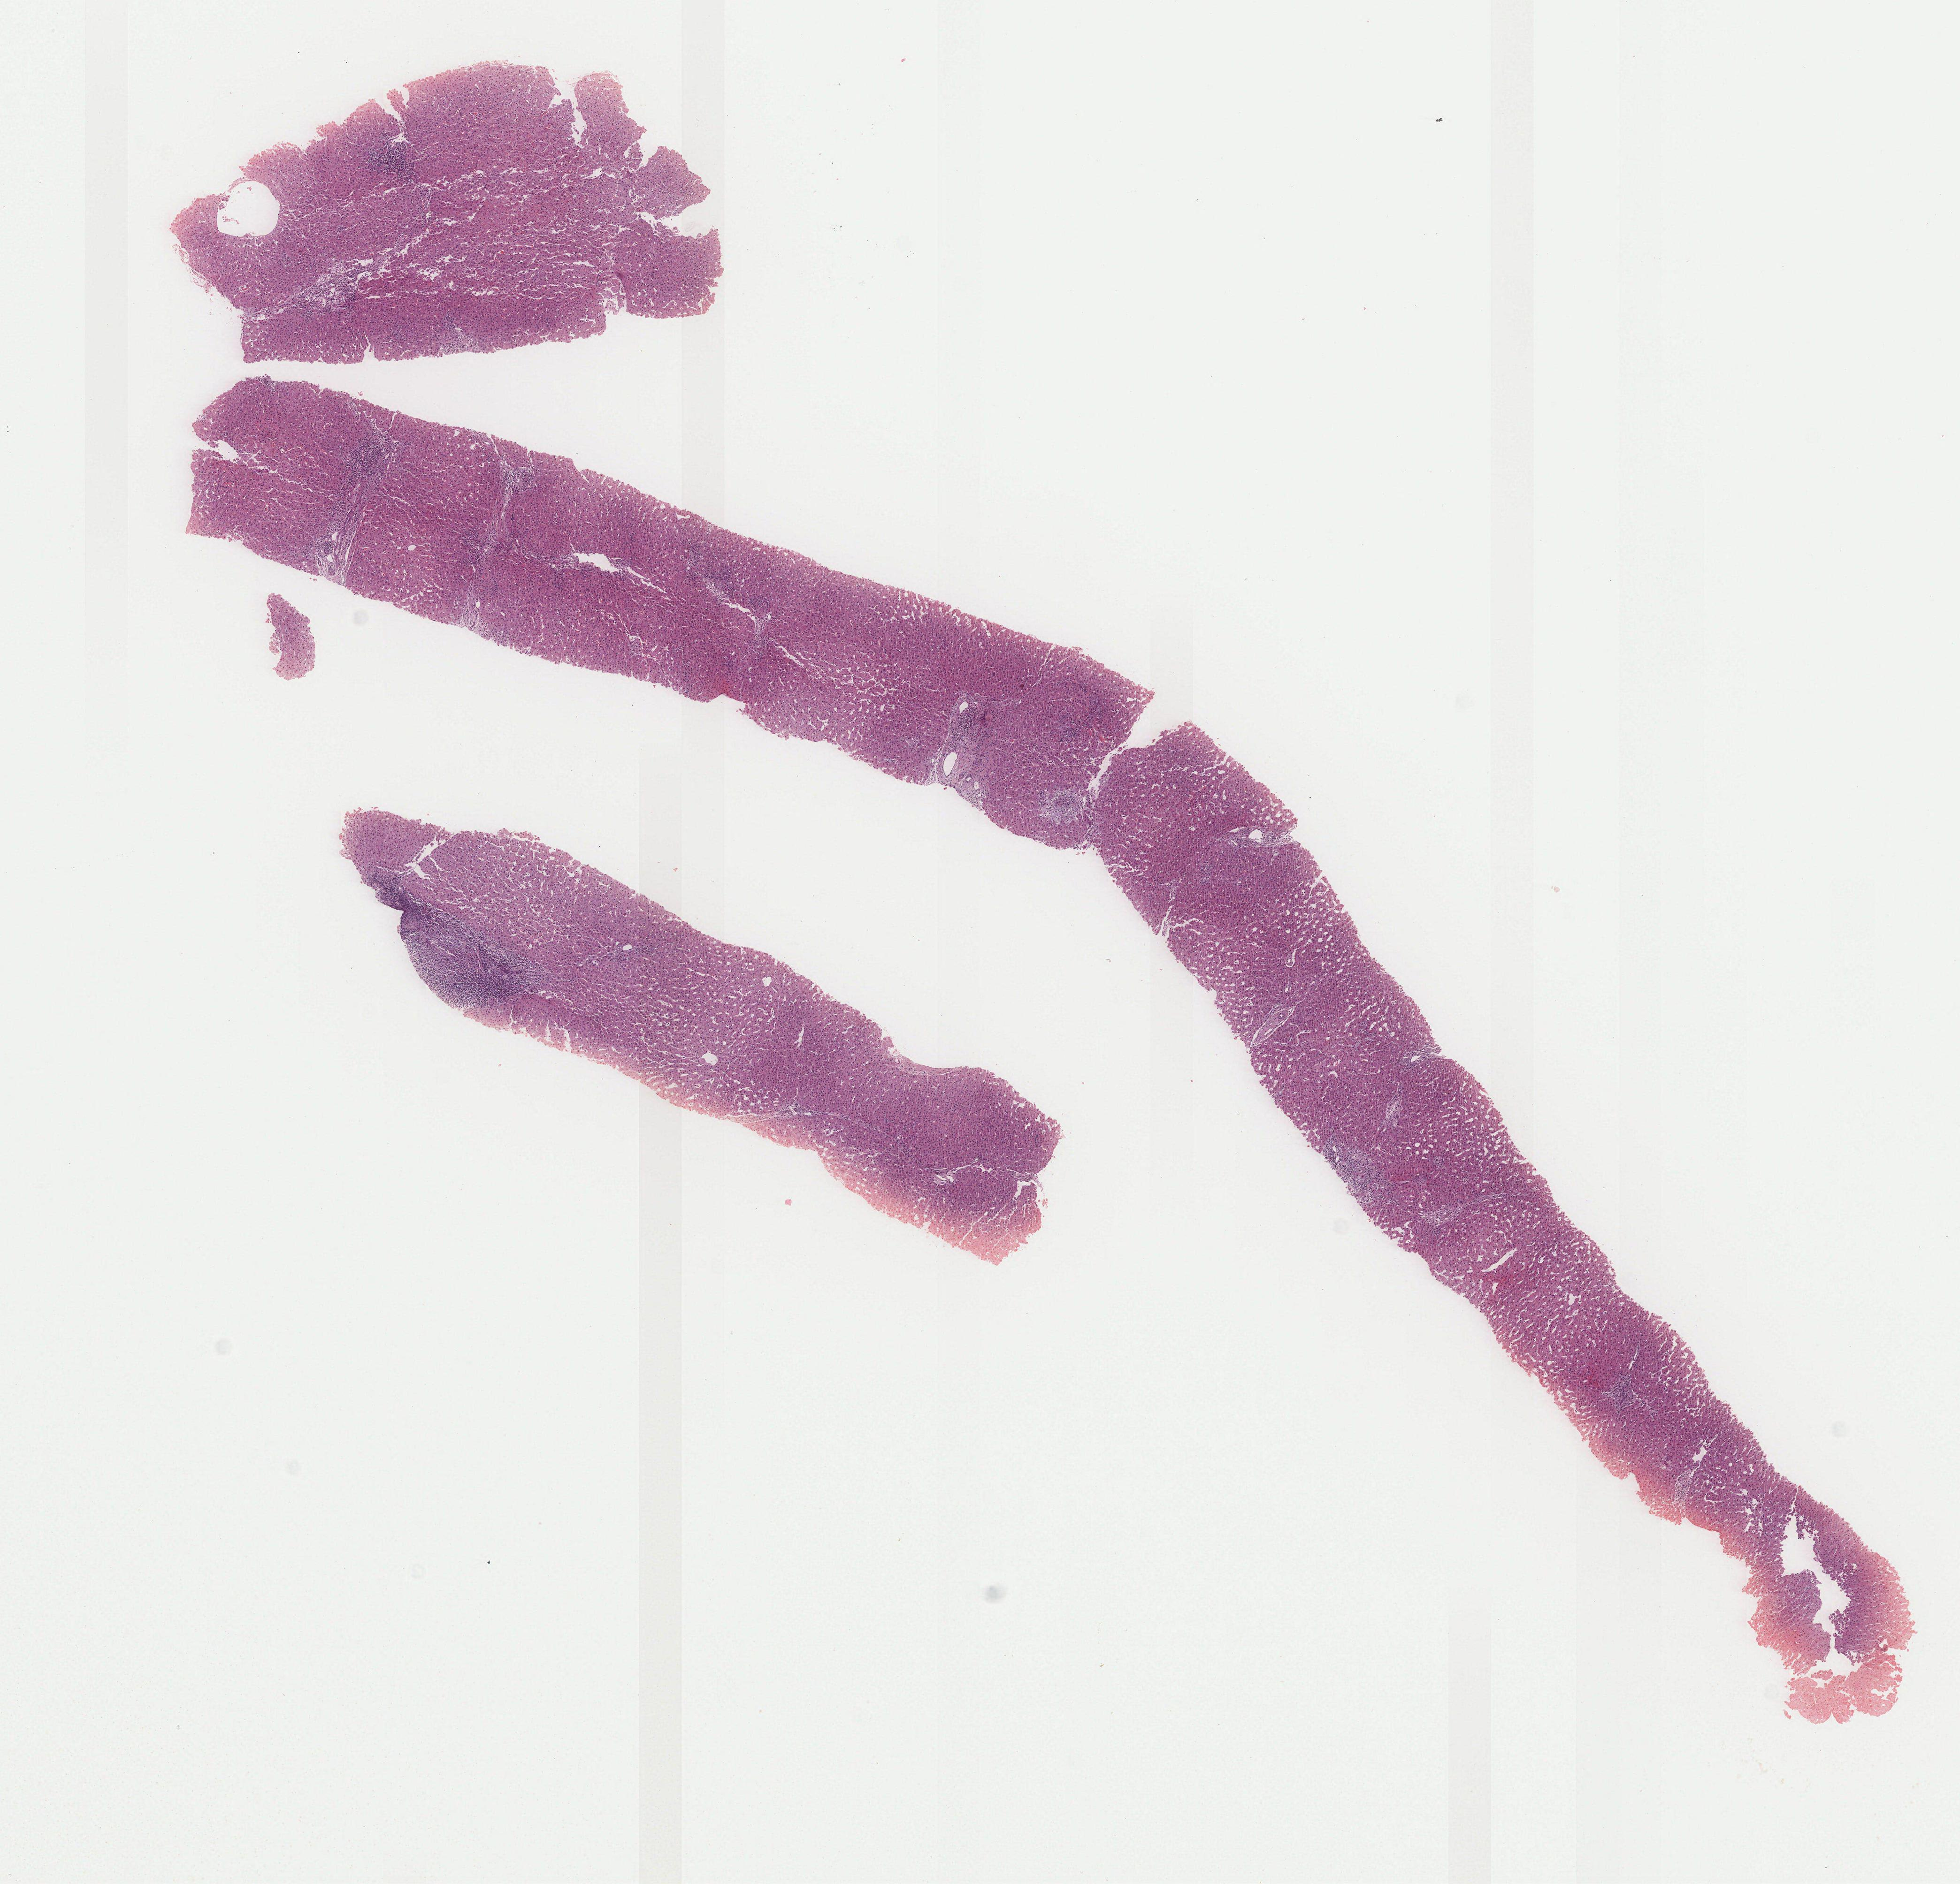

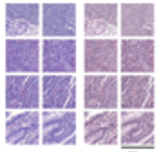


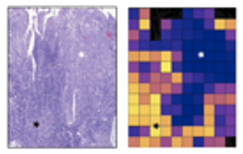

SPOKE 4
Precision Diagnostics
The challenge
From the laboratory to clinical practice
Deep Learning helps discriminating Autoimmune Hepatitis and Primary Biliary Cholangitis
Gerussi & Saldanha et al
JHEP Reports 2024 accepted
Patients
Liver biopsy
Slide scanner
Digital Slide
Tesselation
Normalization
Transformer-based feature extractor
Saved features
Multiple Instance Learning
Visualization
FC
-
748
PBC
AIH

Slide 14
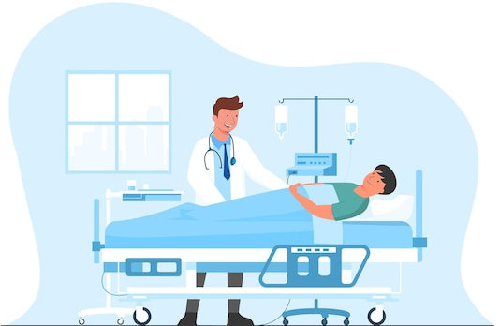





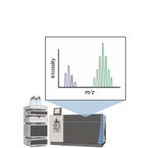


SPOKE 4
Precision Diagnostics
Forecasts after the project is closed
Making precision diagnostics the new frontier of diagnosis and management of rare, chronic and tumor diseases
LABORATORY
PATIENT
PRECISION DIAGNOSTICS

Slide 15


