Slide 1


Slide 2

SPOKE 8: Clinical Exploitation
Clinical validation and implementation of innovative predictive, preventive, diagnostic and therapeutic precision medicine approaches, based on established or emerging molecular and clinical phenotyping and AI-driven decision-making protocols
Specific aims
  To provide proof-of-concept evidence for the clinical usefulness of new strategies supported by sound preclinical backgrounds
  To improve the ability of prognostication and risk stratification to offer early intervention when needed, while avoiding useless treatments
  To better use available resources to prevent treatment toxicity while expanding the magnitude of expected benefit in properly selected patients
  To make the current state-of-the-art of precision medicine available for patients and caregivers by implementing networks for the management of molecular and clinical information

Slide 3
SPOKE 8: Clinical Exploitation
15 Institutions - 46 Researchers
UNIPI (Spoke Leader)
IFO-IRE
M. NEGRI
S. ORSOLA
SAPIENZA
TLS
TOR VERGATA
UNIBO
UNICA
UNICT
UNIMIB
UNIMORE
UNIPA
UNIVR
UPMC
25 Researchers
in Spoke 8
in Spoke 2
5 in Spoke 3
1 in Spoke 4
in Spoke 6
Affiliates

Slide 4
SPOKE 8: Clinical Exploitation
15 Institutions - 46 Researchers
UNIPI (Spoke Leader)
IFO-IRE
M. NEGRI
S. ORSOLA
SAPIENZA
TLS
TOR VERGATA
UNIBO
UNICA
UNICT
UNIMIB
UNIMORE
UNIPA
UNIVR
UPMC
WP1: 4 Tasks
10 Institutions
17 Researchers
WP2: 3 Tasks
6 Institutions
7 Researchers
Affiliates
WP4: 3 Tasks
6 Institutions
10 Researchers
WP5: 2 Tasks
2 Institutions
4 Researchers
WP3: 4 Tasks
8 Institutions
10 Researchers

Slide 5
SPOKE 8: Clinical Exploitation
Cancer
  Colorectal, HCC, cholagiocarcinoma, breast, lung, thyroid, pancreatic, melanoma, GBM, AML, CLL
Metabolism
  T2D, gestational diabetes, post-transplant diabetes, NAFLD/MAFLD
CVD
  Atherosclerosis, HF, arrhythmias, hypertension
Rare Diseases
  Systemic sclerosis, alkaptonuria
HTA
  Evaluation and implemetation of innovative precision medicine technologies in clinical care

Slide 6
SPOKE 8: Clinical Exploitation

Slide 7
SPOKE 8: Clinical Exploitation
 | Cancer | Metabolism | CVD | Rare diseases | Total
Ongoing clinical studies | 19 | 8 | 4 | 2 | 33
Ongoing preclinical studies | 7 | 5 | 2 | 2 | 16
Total | 26 | 13 | 6 | 4
49

Slide 8
SPOKE 8: Clinical Exploitation
 | Cancer | Metabolism | CVD | Rare diseases | Total
Ongoing clinical studies | 19 | 8 | 4 | 2 | 33
Ongoing preclinical studies | 7 | 5 | 2 | 2 | 16
Total | 26 | 13 | 6 | 4
49

Slide 9
SPOKE 8: Clinical Exploitation
 | Cancer | Metabolism | CVD | Rare diseases | Total
Ongoing clinical studies | 19 | 8 | 4 | 2 | 33
Ongoing preclinical studies | 7 | 5 | 2 | 2 | 16
Total | 26 | 13 | 6 | 4
49

Slide 10
SPOKE 8: Clinical Exploitation
Recruitment
RTDA:
  13 recruited (8M, 5F)
  8 in Spoke 8, 3 in Spoke 6, 2 in Spoke 3
PhD students:
  13 recruited (5M, 8F)
  9 in Spoke 8, 2 in Spoke 3, 1 in Spoke 2, 1 in Spoke 4

Slide 11
SPOKE 8: Clinical Exploitation
∽ 80 full length peer reviewed publications (as of May 31th)
Several participations at national and international congresses
Regular meetings intra-Spoke, inter-Spokes and/or with the Hub on scientific and/or organizational issues

Slide 12
SPOKE 8: Clinical Exploitation
Cascade funding
Extensive sequencing for the molecular characterization of tumor samples and liquid biopsies and comparison with in-house techniques.
Development of in depth, additional molecular characterization of cardiometabolic disorders to identify mechanisms of risk and conceive clinical strategies targeting molecular defects of diseased cells.
Novel strategies for faster clinical protocol development, as well as more effective study coordination and data management.

Slide 13
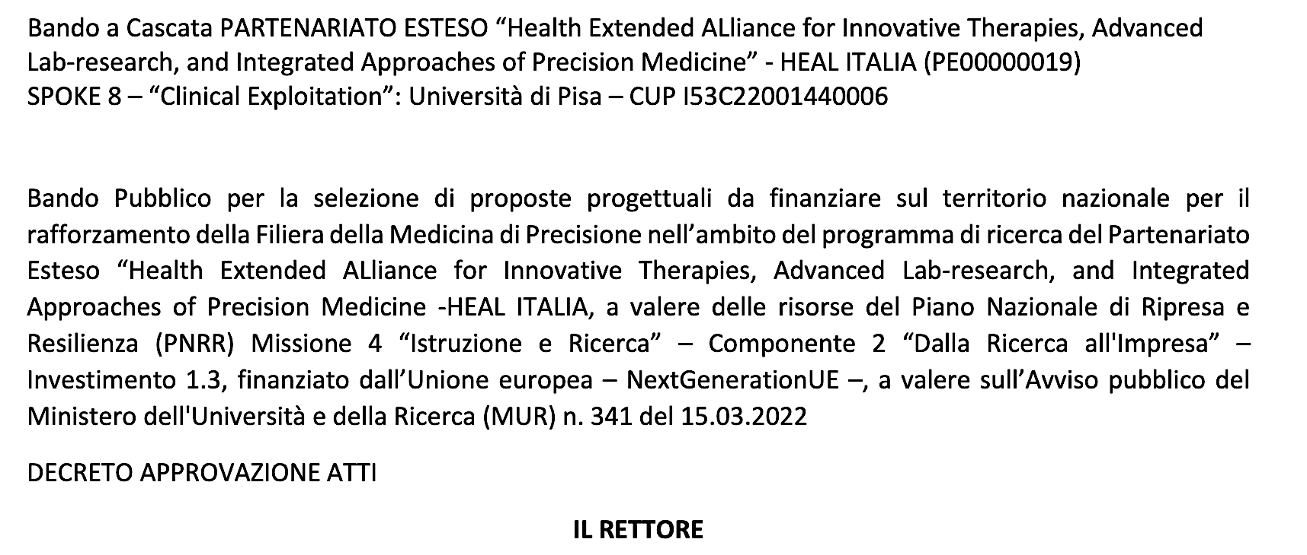

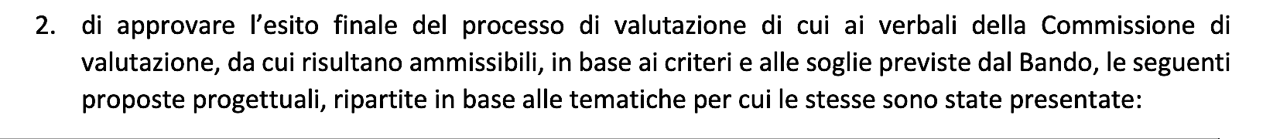
SPOKE 8: Clinical Exploitation

Slide 14
SPOKE 8: Clinical Exploitation
Commitments
  To complete clinical and pre-clinical studies in due time
  To improve public engagement
  To further foster collaborations between WPs in the Spoke and between Spoke 8 with other Spokes
  To promote network implementation
  To carefully monitor the execution of cascade funding projects
  To further support and spur researchers in their reporting activity
  To keep budget monitoring timely and factual
  To prepare Spoke 8 legacy in terms of established networks, generated datasets, implemented diagnostic and therapeutic technological platforms and exploitation of results beyond 2025

Slide 16


