Slide 1
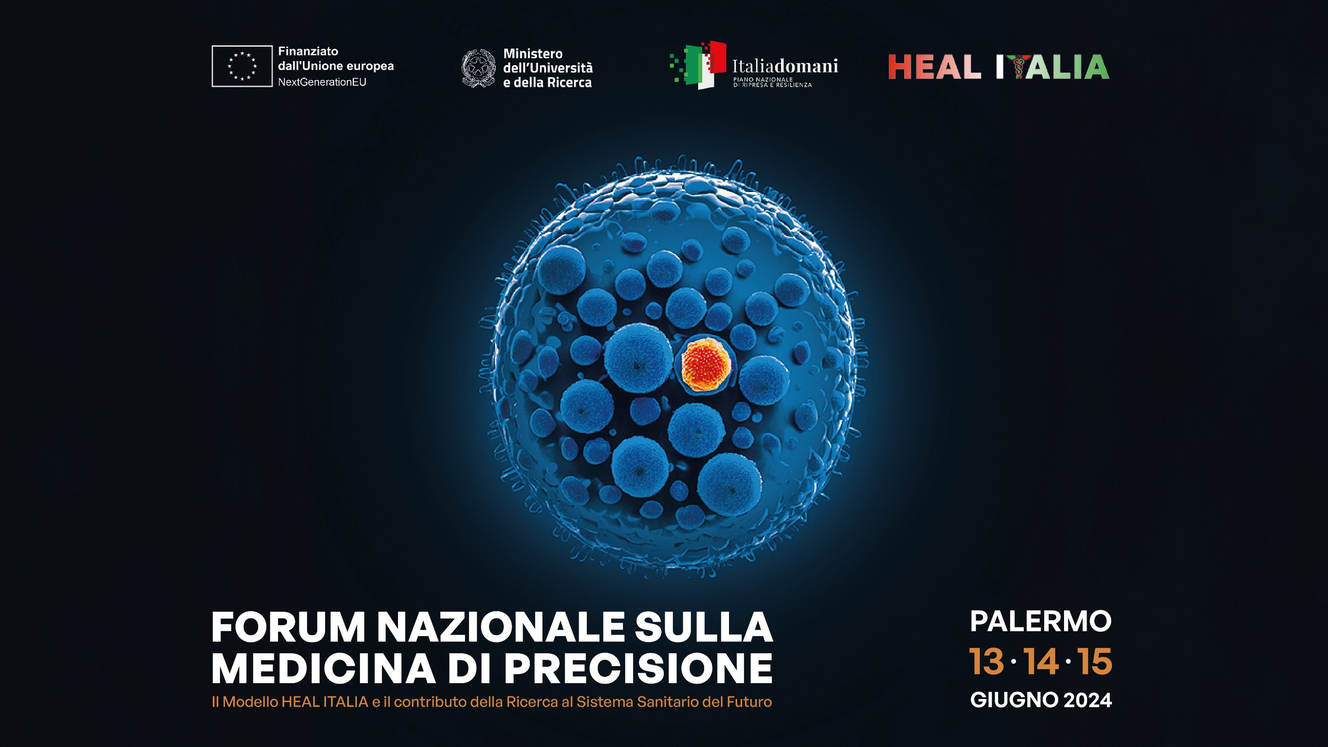

Slide 2
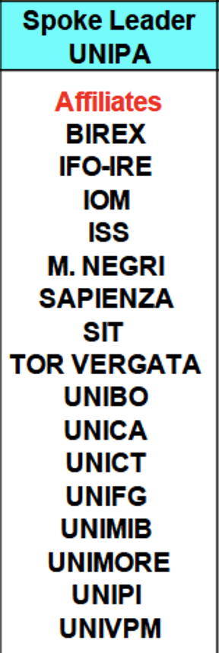


SPOKE 3
Prediction Models
n. of researchers: 60+
4 PhD students

Slide 3
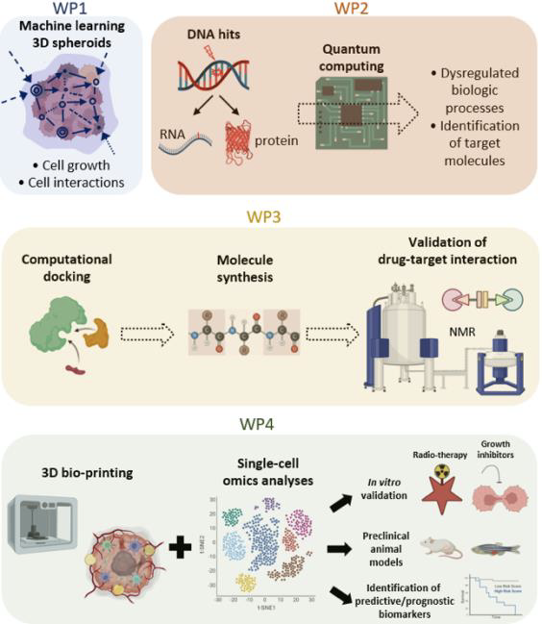
PREDICTION MODELS (UniPA)
Development of advanced prediction models for prognosis and therapeutic response based on comprehensive data treatment
The realization of this activity will be facilitated by the already established protocol for the isolation and purification of organoids and model recapitulating the complex evolution of a cell even following an action of an external agent (drug, radiation, etc.). Organoids, fibroblasts, adipose, mesenchymal, endothelial and immune cells will be 3D bioprinted. This 3D structure, which will also be simulated through existing analytical tissue growth codes, will be investigated by evaluating the action of specific compounds selected by the consortium and radiotherapy. Its development following the external action will be monitored and the "physiopathology" will be analyzed and simulated with machine learning approaches capable of reproducing the complex mechanisms of cellular communication.
WP 1: Integrated experimental and computational models of 3D cultures of human cells with specific gene mutations or biogenesis alterations of RNA/Proteins;
WP 2: Simulation of mutated proteins and complex structures through quantum computing and AI;
WP 3: Pharmacophoric dynamic docking simulations of genetic altered molecules;
WP4: Preclinical models for precise therapeutic and diagnostic prevention strategies.

Slide 4
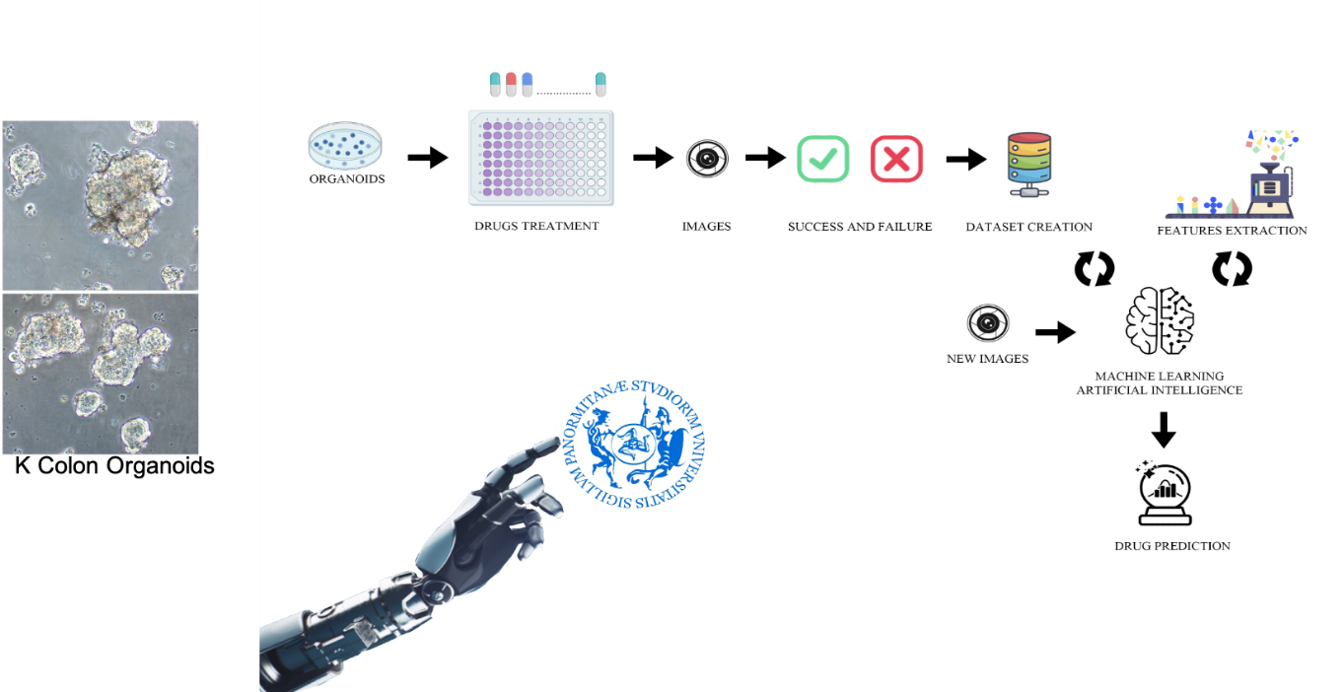
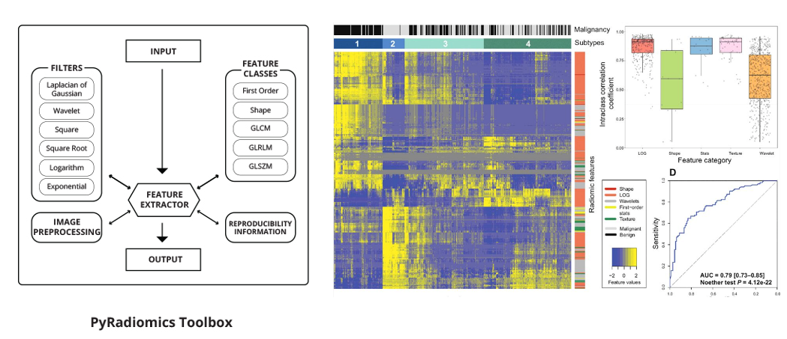
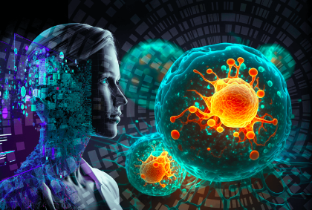
WP 1: Integrated experimental and computational models of 3D cultures of human cells with specific gene mutations or biogenesis alterations of RNA/Proteins
Task 1.1: 3D simulation of spheroid structures through machine learning (UNIPA: G. Raso, D. Tegolo, S. Vitabile, G. Cicceri, S. Di Bella; BIREX: D. Mascolo)
Radiomics: All feature classes, with the exception of shape can be calculated on either the original image and/or a derived image, obtained by applying one of several filters.
A benchmarking of deep learning models for automatic
classification of intestinal organoids

Slide 5
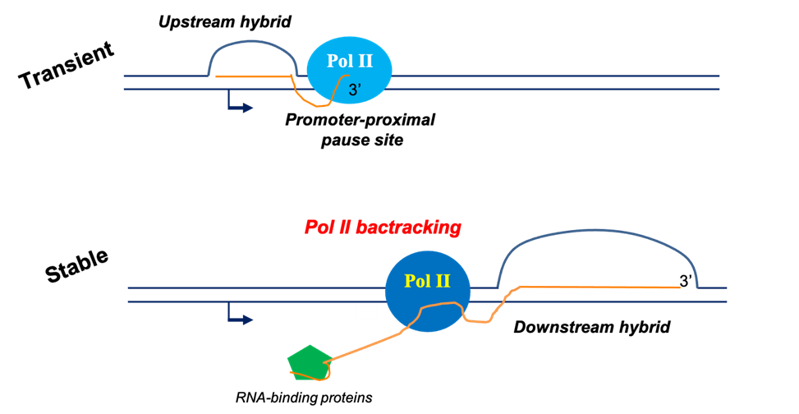
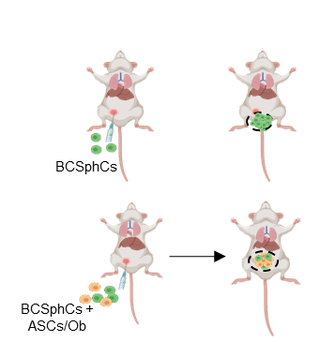
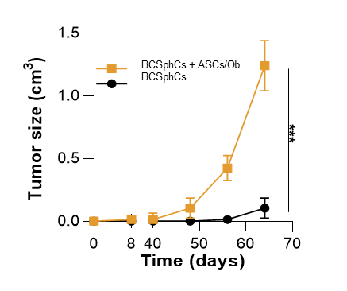
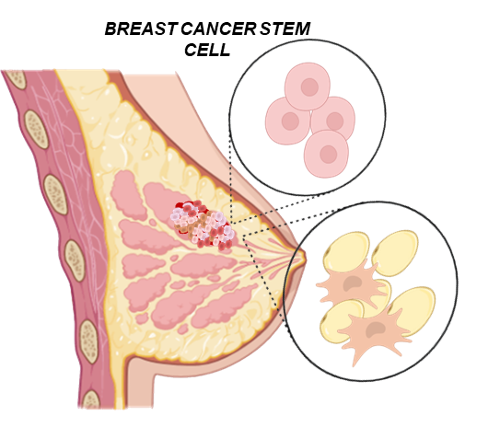
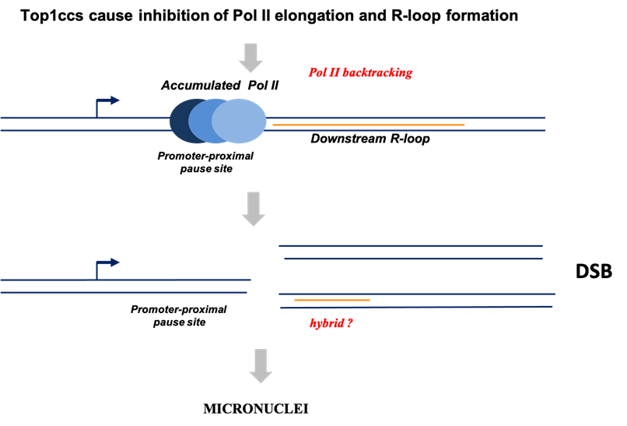
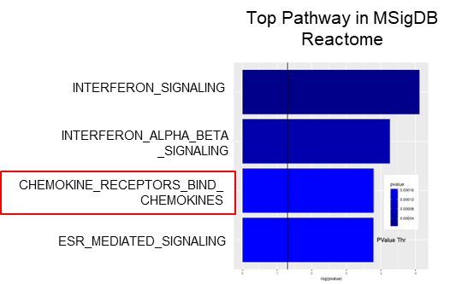
WP 1: Integrated experimental and computational models of 3D cultures of human cells with specific gene mutations or biogenesis alterations of RNA/Proteins
Task 1.2: Regulatory molecular circuits of 3D cell growth affecting physio-pathological cell phenotypes (UNIPA: M. Todaro; UniBO: G. Capranico)
Topoisomerase I-DNA cleavage complexes (Top1ccs) cause genome instability through Transcription-Replications conflicts (TRCs) increase
How does the adipose tissue in obese patient influence the development and progression of breast cancer?

Slide 6
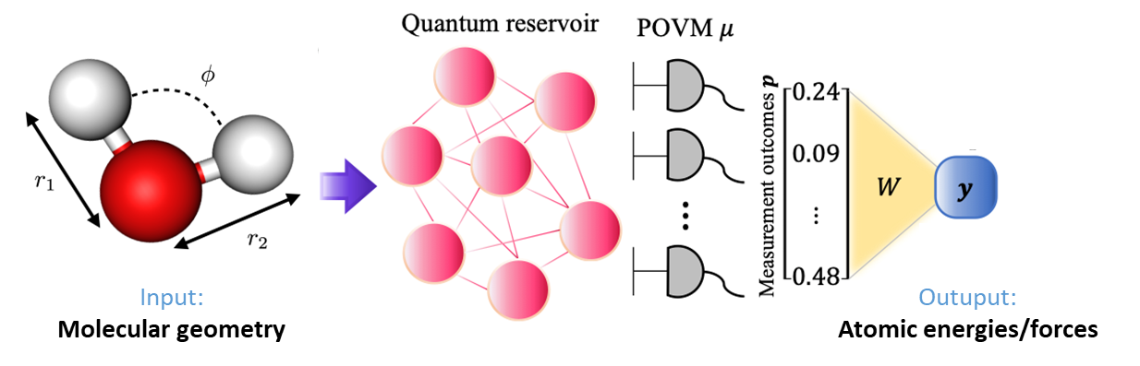
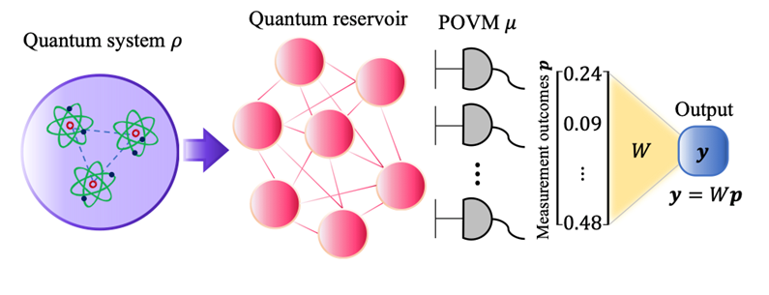
WP 2: Simulation of mutated proteins and complex structures through quantum computing and AI
Task 2.1: Quantum computing techniques applied to biochemical systems, molecular biology and organic chemistry (UNIPA: G.M. Palma)
Quantum Extreme Learning Machine (QELM)
New efficient ways to establish if the dynamics of a reservoirs is suited to a QELM algorithms.
The paradigm: Supervised quantum machine learning.
The quantum devices is “trained” to learn the functional relation between provided input and output. The data are encoded in the device as quantum states of some qubits interacting with a reservoir. The output is obtained measuring the reservoir plus classical post-processing.

Slide 7
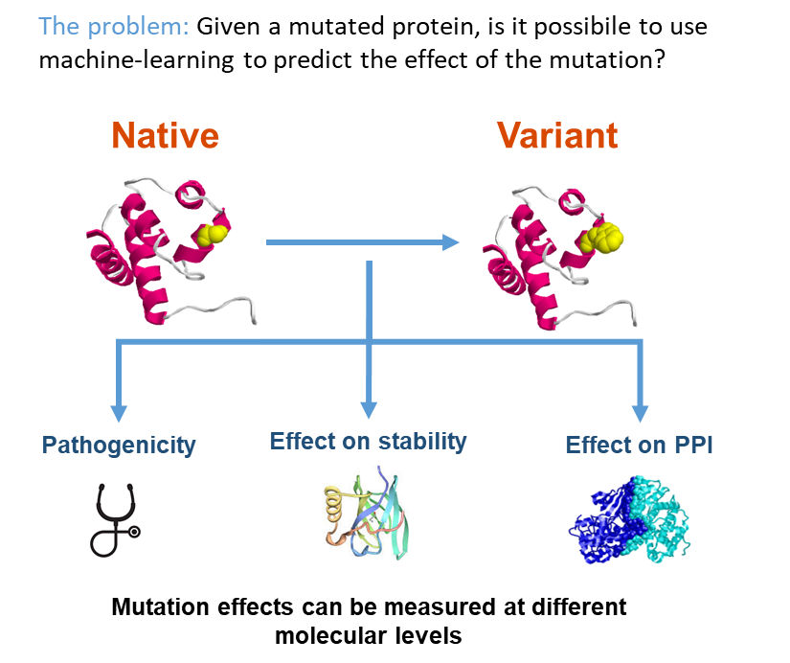
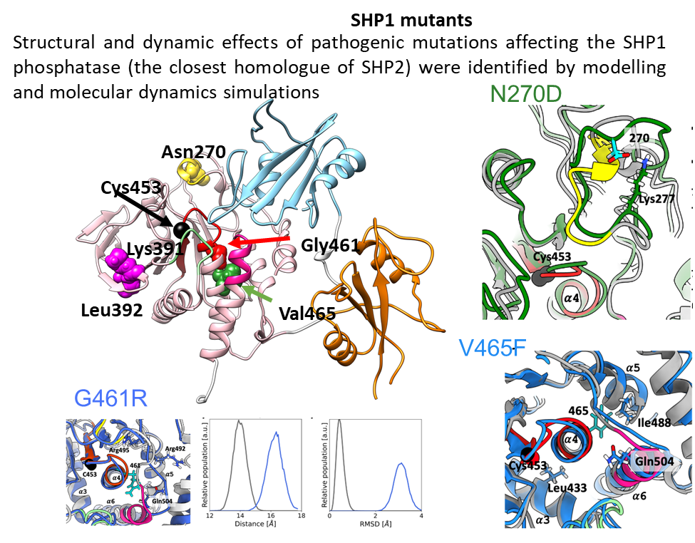
WP 2: Simulation of mutated proteins and complex structures through quantum computing and AI
Task 2.2: Integrative in silico assessment of the impact of mutations on protein structure, function, and interactions (UniTOR VERGATA: L. Stella; UniBO: C. Savojardo)
Providing ML models for the prediction of the overall effect of mutations on characteized proteins

Slide 8
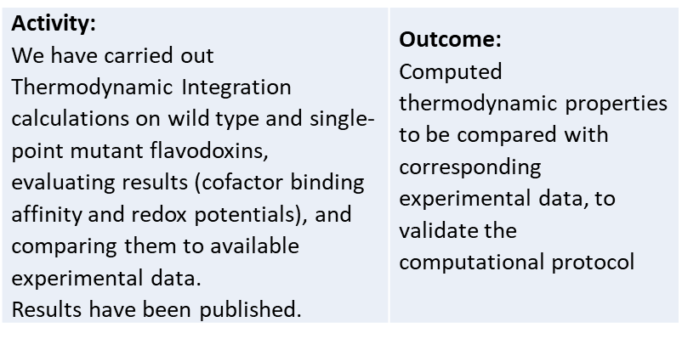
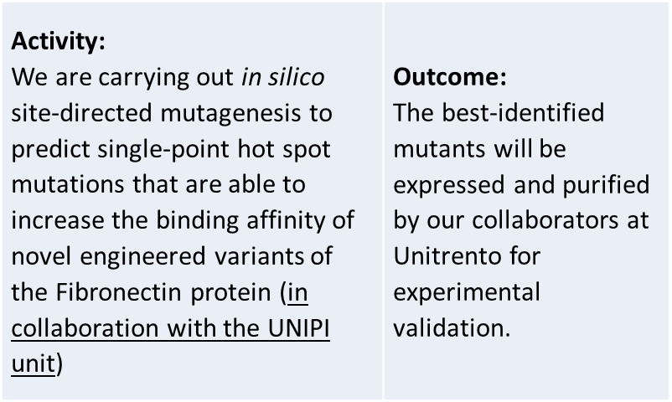
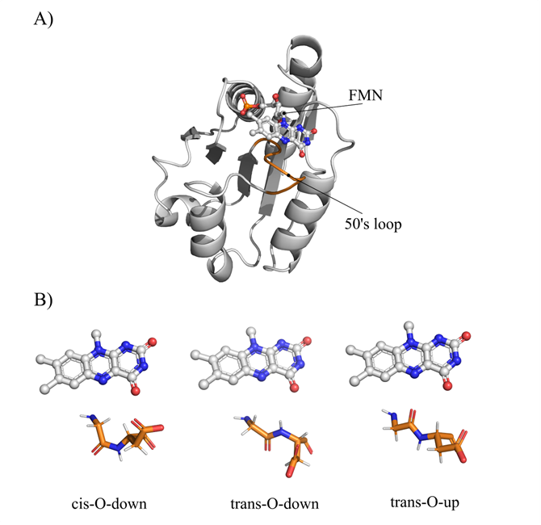
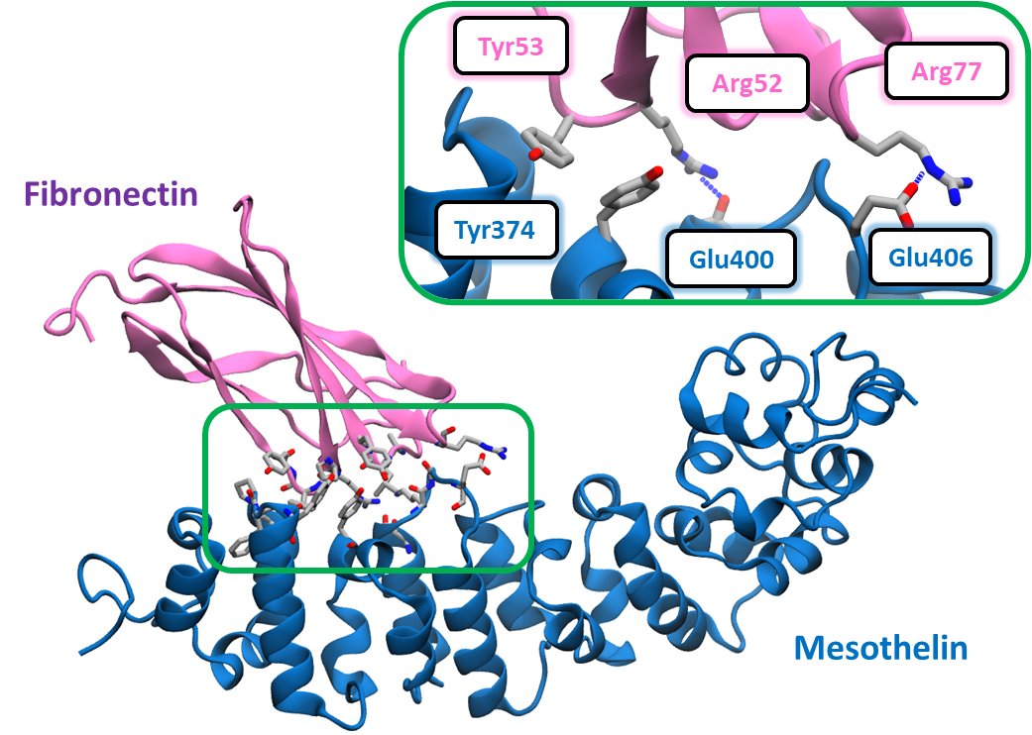
WP 3: Pharmacophoric dynamic docking simulations of genetic altered molecules
Task 3.1: Computation of molecule bearing genetic alterations able to bind to the target in the most effective way possible (docking) and with the greatest affinity (search for the best scoring) (UNIPA: A. Barone, G. Spinello; BIREX: M. Pulvirenti; UniMIB: L. De Gioia)

Slide 9
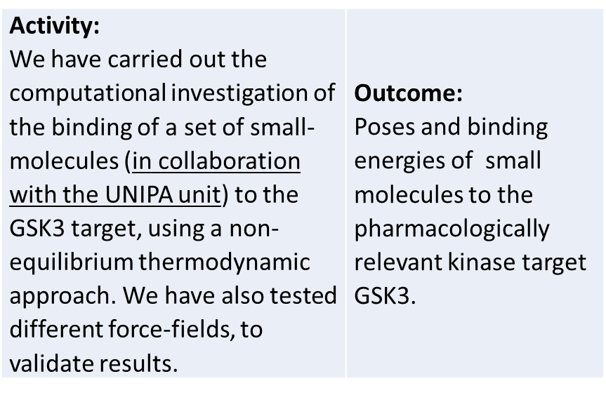
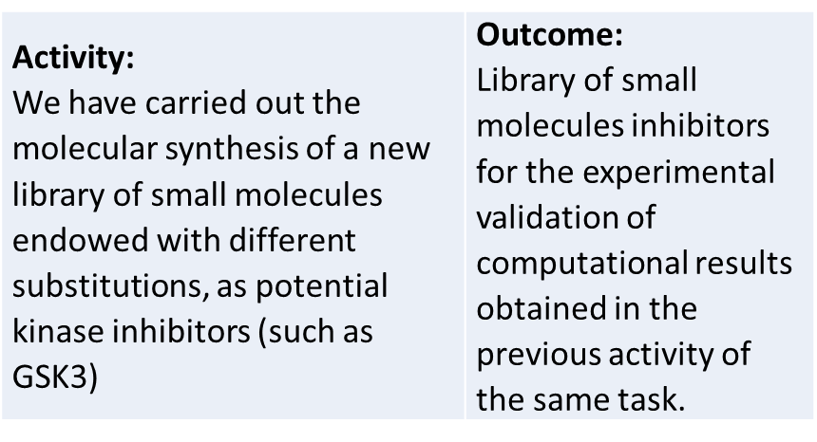
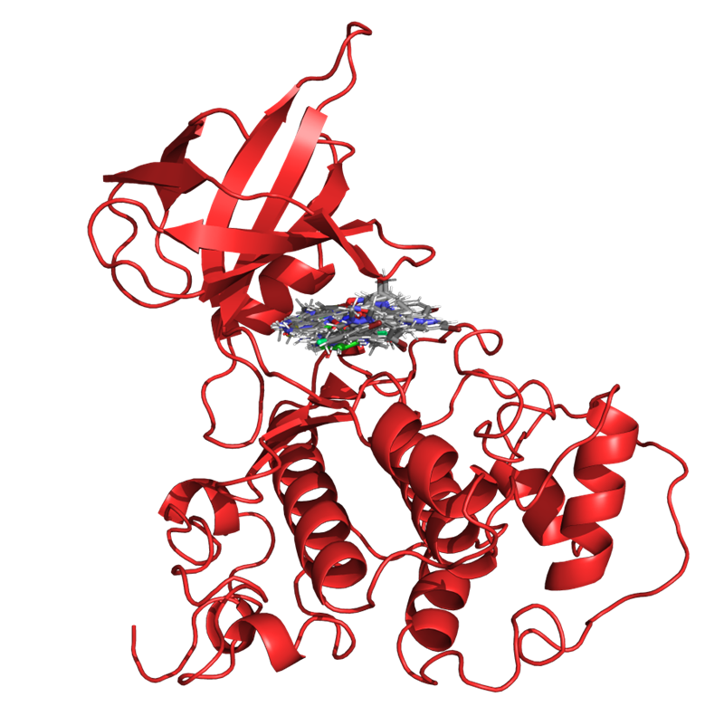
WP 3: Pharmacophoric dynamic docking simulations of genetic altered molecules
Task 3.2: Molecular synthesis for the experimental validation of computation models (UNIPA: P. Diana; UniBO: C. Savojardo)
Non-Equilibrium Thermodynamic Integration in drug design: inhibitors of proteins
Molecular synthesis for the experimental validation of computation models

Slide 10
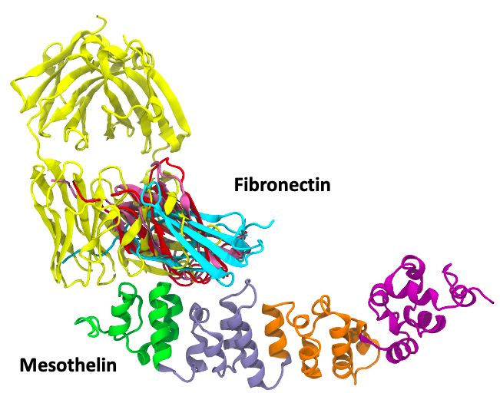
WP 3: Pharmacophoric dynamic docking simulations of genetic altered molecules
Task 3.3: Fight the enemy before you can see it: moving tools for early diagnosis from bench to bedside (UniPI: F. Minutolo, S. Landi)
Establishment of the optimal conditions for the immunostaining of the MSLN-overexpressing with Fn3, an anti-His-tag and an anti-MSLN antibody. For these preliminary experiments we employed only MSTO_clone_1. Further investigation of the “three-component” reaction as a better strategy compared to the Sonogashira coupling to obtain the desired probes.
Docking algorithm | Binding affinity (kcal/mol)
Cluspro | -22.9 + 4.6
Hdock | -5.4 + 4.0
pydock | -6.9 + 4.6

Slide 11
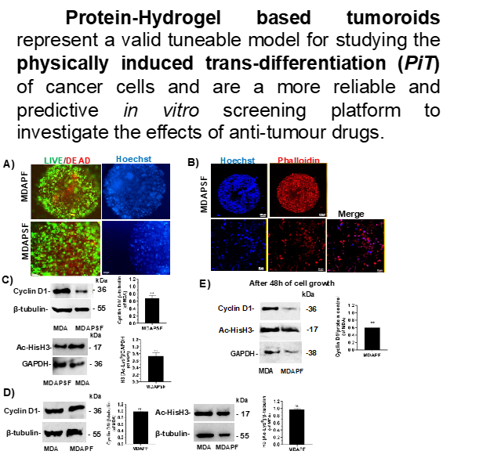
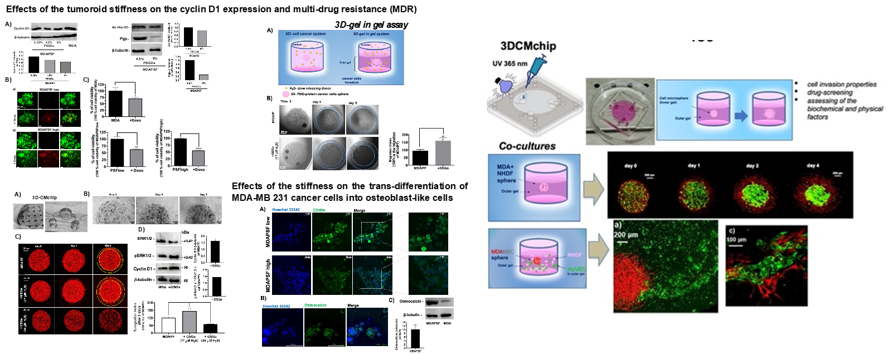
WP4: Preclinical models for precise therapeutic and diagnostic prevention strategies (UNIPA: G. Stassi)
Task 4.1: Modeling of 3D approaches of multicellular spheroids structures for estimating the risk of disease initiation and progression (UNIPA: G. Stassi; IFO-IRE: A. Bagnato, G. Blandino, D. Donzelli; ISS: E. Ambrosini, P. Picchieri, B. Serafini, A. Zeuner; UniMIB: R. Fruscio, A. L. Vescovi; UniMORE: V. Zappavigna; UniPI: S. Danti, F. Minutolo; UniTOR VERGATA: S. Melino)
Optimization of 3D cell-culture models for studying cancer cell proliferation

Slide 12
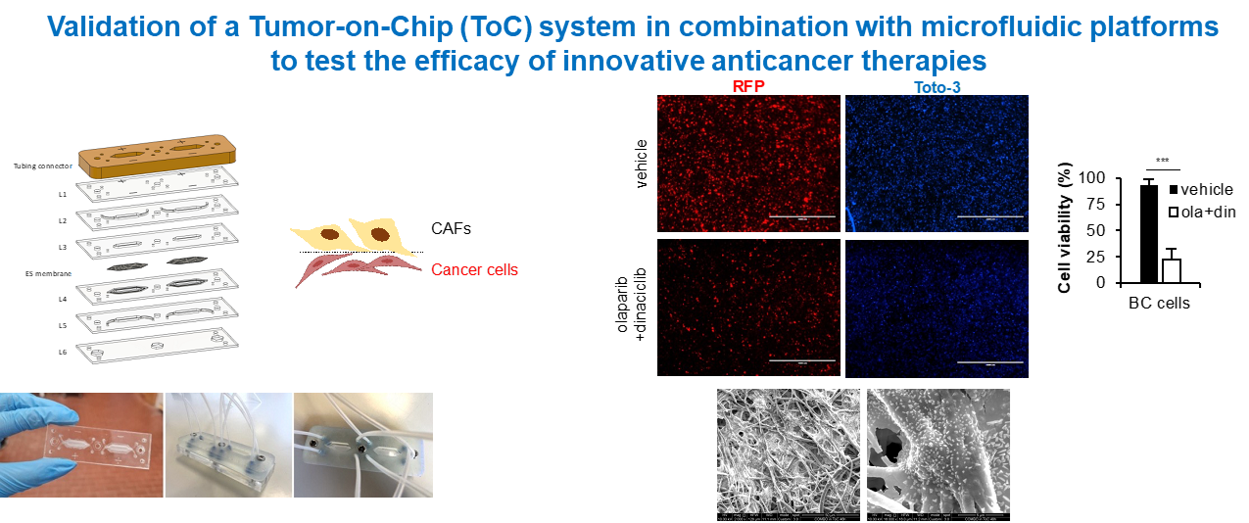
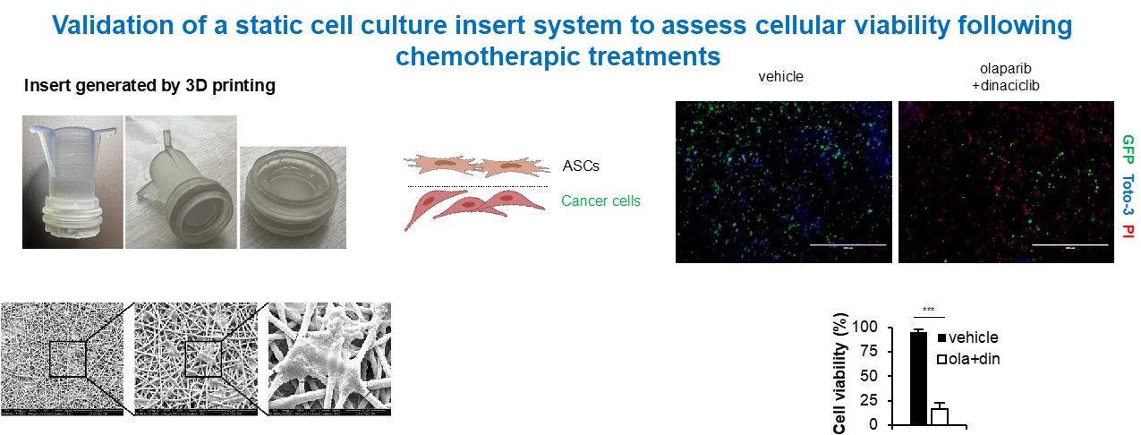
WP4: Preclinical models for precise therapeutic and diagnostic prevention strategies (UNIPA: G. Stassi)
Task 4.1: Modeling of 3D approaches of multicellular spheroids structures for estimating the risk of disease initiation and progression (UNIPA: G. Stassi; IFO-IRE: A. Bagnato, G. Blandino, D. Donzelli; ISS: E. Ambrosini, P. Picchieri, B. Serafini, A. Zeuner; UniMIB: R. Fruscio, A. L. Vescovi; UniMORE: V. Zappavigna; UniPI: S. Danti, F. Minutolo; UniTOR VERGATA: S. Melino)

Slide 13
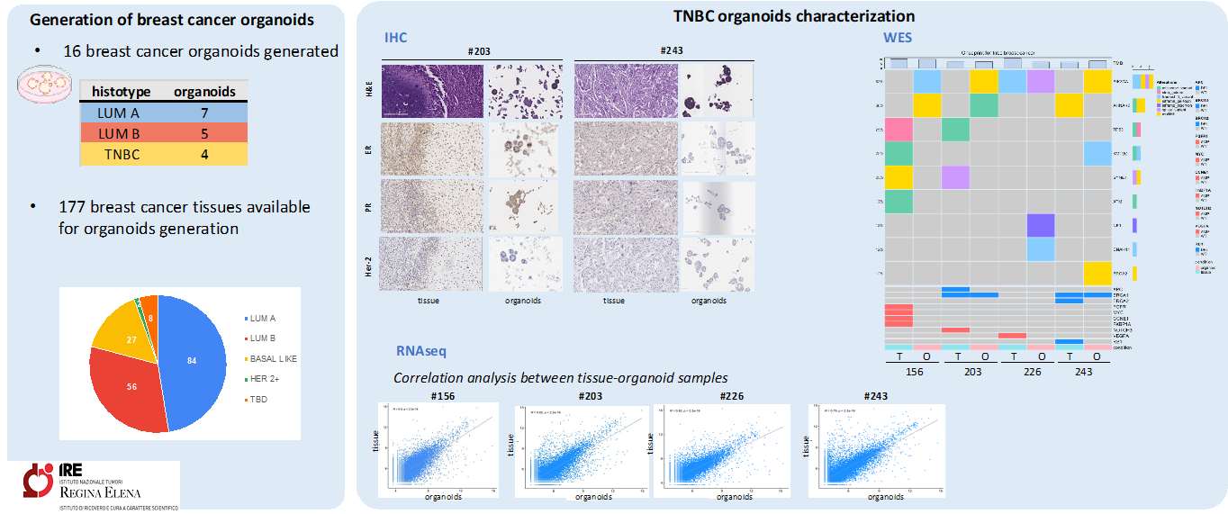
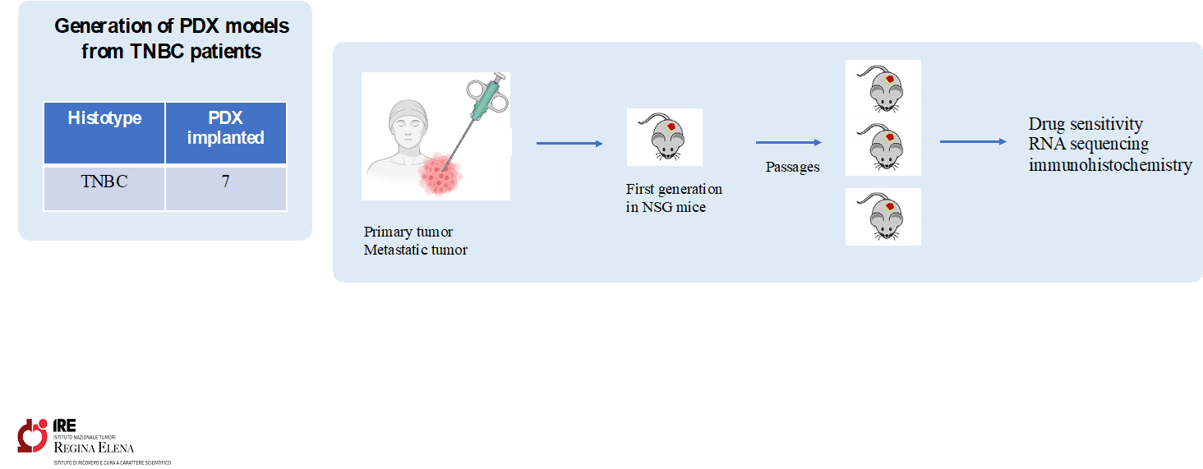
WP4: Preclinical models for precise therapeutic and diagnostic prevention strategies (UNIPA: G. Stassi)
Task 4.1: Modeling of 3D approaches of multicellular spheroids structures for estimating the risk of disease initiation and progression (UNIPA: G. Stassi; IFO-IRE: A. Bagnato, G. Blandino, D. Donzelli; ISS: E. Ambrosini, P. Picchieri, B. Serafini, A. Zeuner; UniMIB: R. Fruscio, A. L. Vescovi; UniMORE: V. Zappavigna; UniPI: S. Danti, F. Minutolo; UniTOR VERGATA: S. Melino)

Slide 14
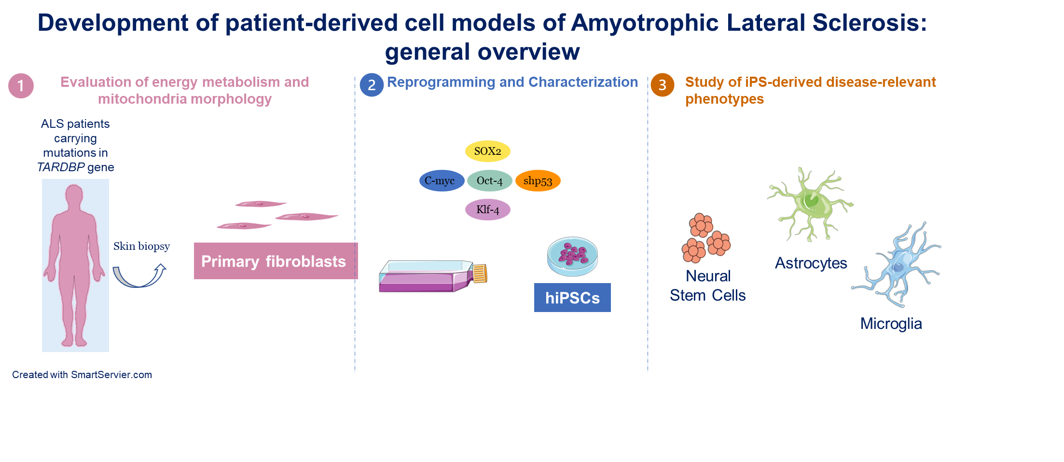
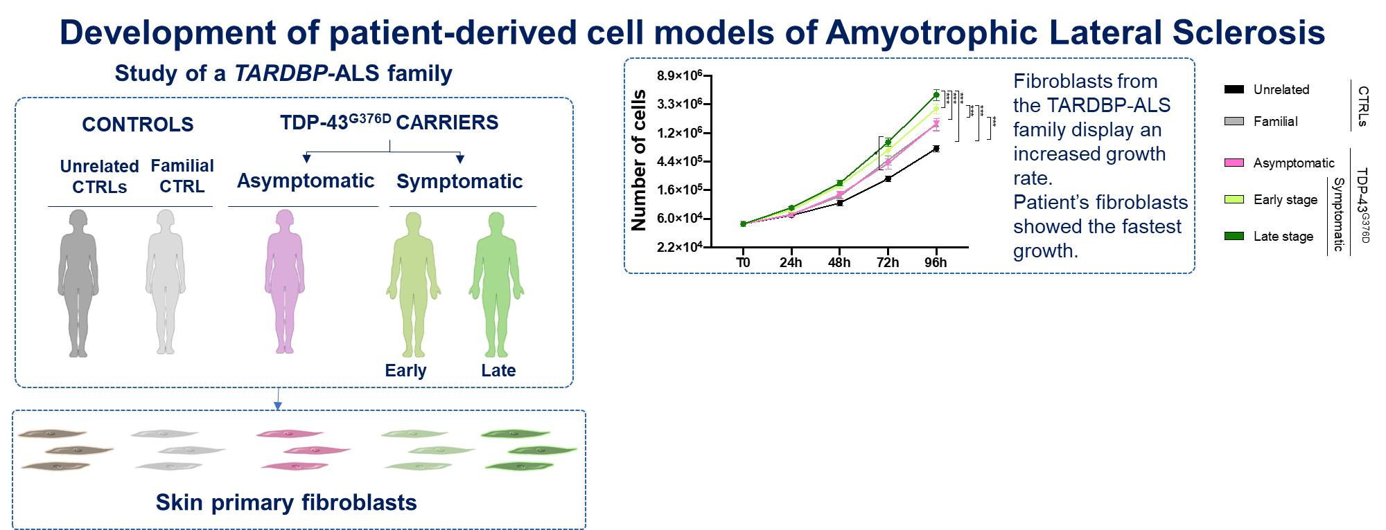
WP4: Preclinical models for precise therapeutic and diagnostic prevention strategies (UNIPA: G. Stassi)
Task 4.1: Modeling of 3D approaches of multicellular spheroids structures for estimating the risk of disease initiation and progression (UNIPA: G. Stassi; IFO-IRE: A. Bagnato, G. Blandino, D. Donzelli; ISS: E. Ambrosini, P. Picchieri, B. Serafini, A. Zeuner; UniMIB: R. Fruscio, A. L. Vescovi; UniMORE: V. Zappavigna; UniPI: S. Danti, F. Minutolo; UniTOR VERGATA: S. Melino)

Slide 15
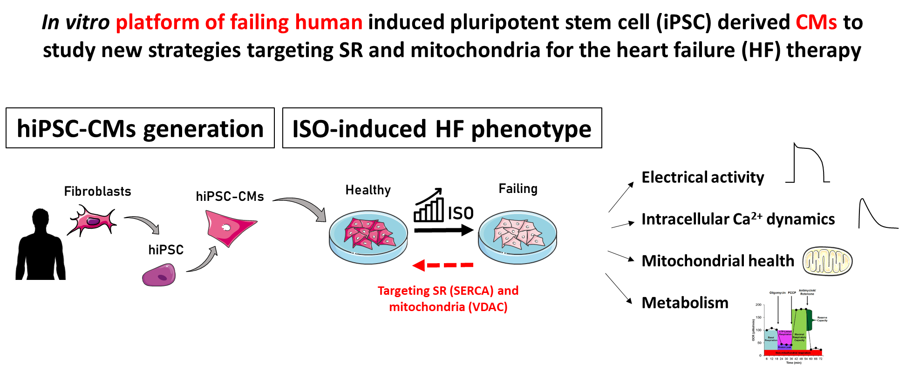
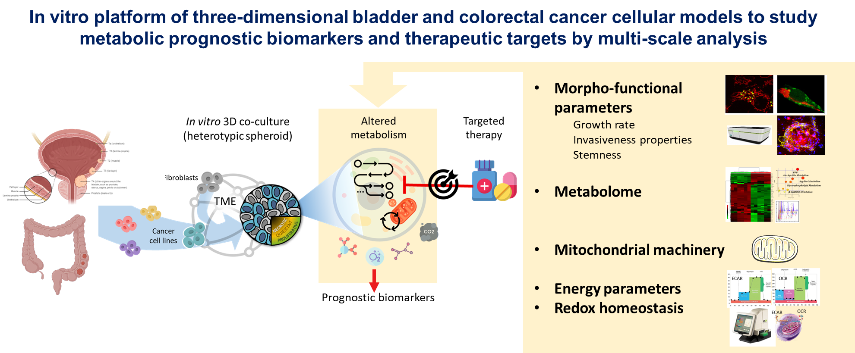
WP4: Preclinical models for precise therapeutic and diagnostic prevention strategies (UNIPA: G. Stassi)
Task 4.1: Modeling of 3D approaches of multicellular spheroids structures for estimating the risk of disease initiation and progression (UNIPA: G. Stassi; IFO-IRE: A. Bagnato, G. Blandino, D. Donzelli; ISS: E. Ambrosini, P. Picchieri, B. Serafini, A. Zeuner; UniMIB: R. Fruscio, A. L. Vescovi; UniMORE: V. Zappavigna; UniPI: S. Danti, F. Minutolo; UniTOR VERGATA: S. Melino)

Slide 16
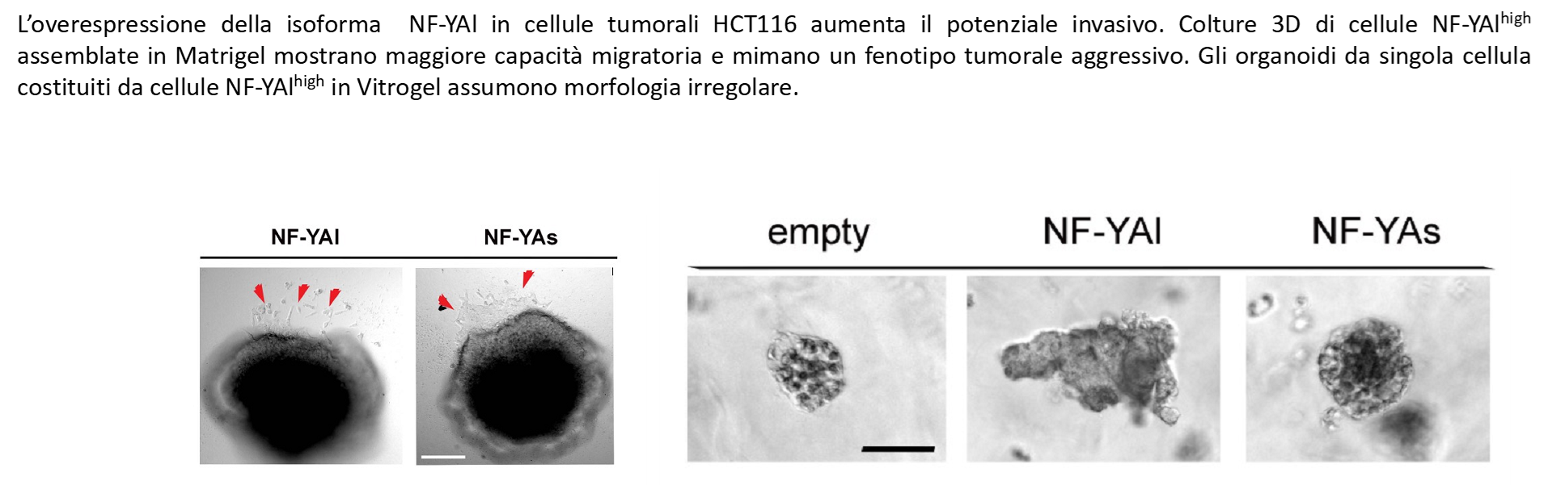
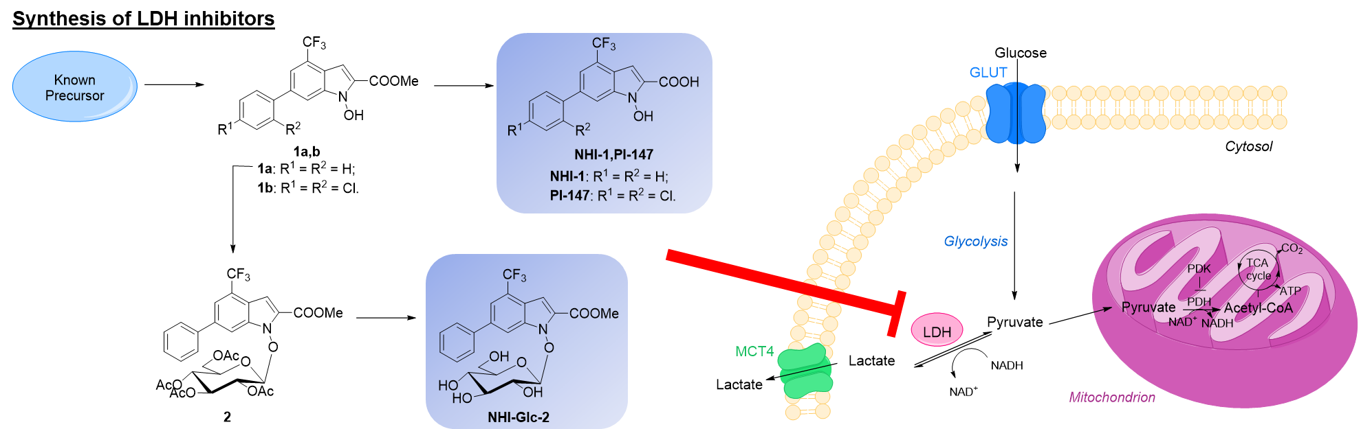
WP4: Preclinical models for precise therapeutic and diagnostic prevention strategies (UNIPA: G. Stassi)
Task 4.1: Modeling of 3D approaches of multicellular spheroids structures for estimating the risk of disease initiation and progression (UNIPA: G. Stassi; IFO-IRE: A. Bagnato, G. Blandino, D. Donzelli; ISS: E. Ambrosini, P. Picchieri, B. Serafini, A. Zeuner; UniMIB: R. Fruscio, A. L. Vescovi; UniMORE: V. Zappavigna; UniPI: S. Danti, F. Minutolo; UniTOR VERGATA: S. Melino)

Slide 17
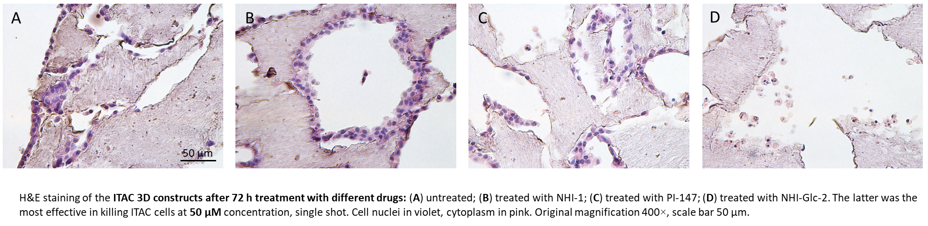
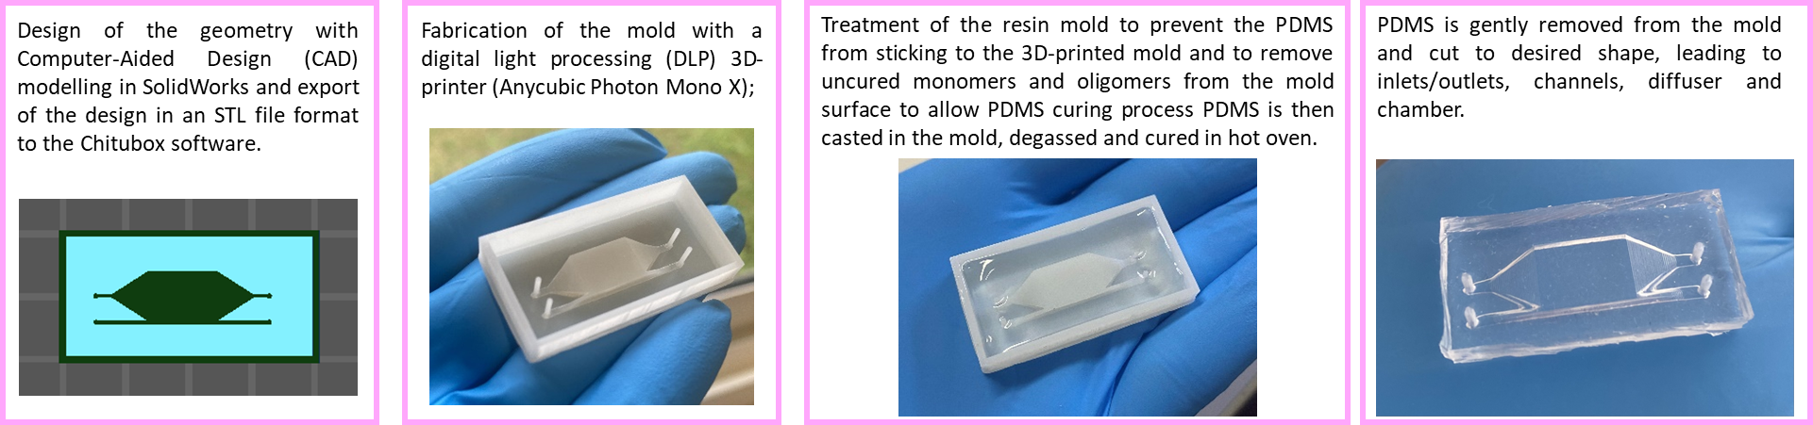
WP4: Preclinical models for precise therapeutic and diagnostic prevention strategies (UNIPA: G. Stassi)
Task 4.1: Modeling of 3D approaches of multicellular spheroids structures for estimating the risk of disease initiation and progression (UNIPA: G. Stassi; IFO-IRE: A. Bagnato, G. Blandino, D. Donzelli; ISS: E. Ambrosini, P. Picchieri, B. Serafini, A. Zeuner; UniMIB: R. Fruscio, A. L. Vescovi; UniMORE: V. Zappavigna; UniPI: S. Danti, F. Minutolo; UniTOR VERGATA: S. Melino)
3D models of sinonasal cancer for testing new drugs
Design and fabrication of a nose-on-chip device

Slide 18
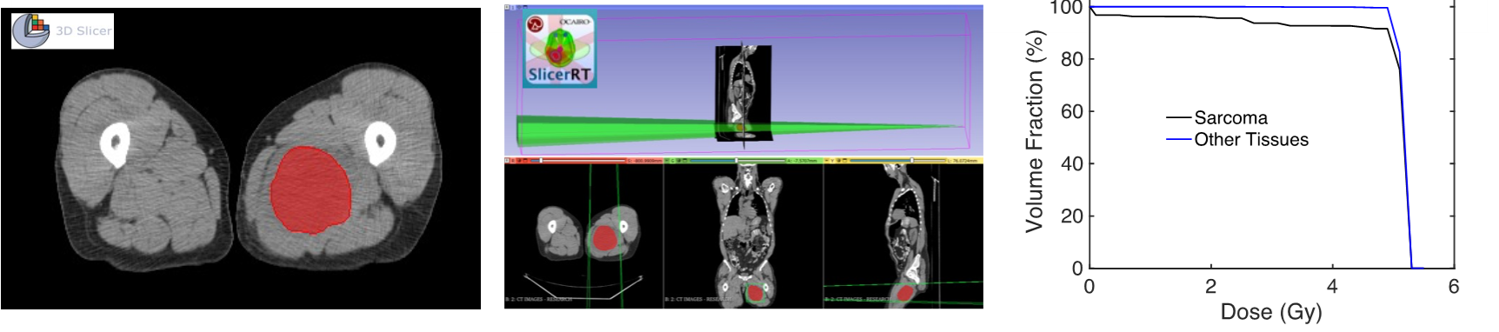
WP4: Preclinical models for precise therapeutic and diagnostic prevention strategies (UNIPA: G. Stassi)
Task 4.2: Development of a powerful in vitro model for the response to radiotherapy in order to make clinical decisions more appropriate for treatment options (UNIPA: G. Stassi; IOM: L. Memeo; UniBO: M. L. Valentino; UniCA: A. Fanti)

Slide 19
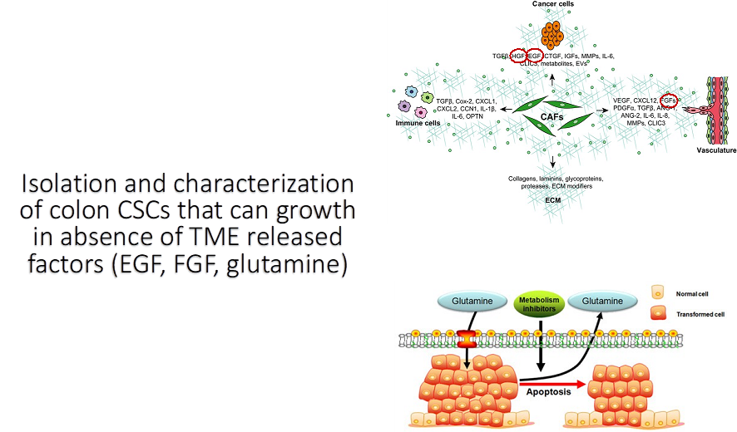
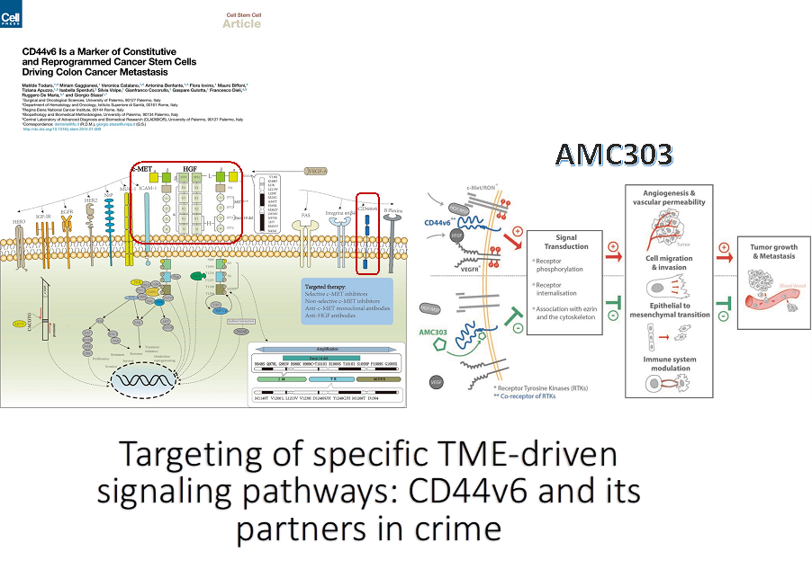
WP4: Preclinical models for precise therapeutic and diagnostic prevention strategies (UNIPA: G. Stassi)
Task 4.3: Validation at single-cell level (UNIPA: G. Stassi; UniBO: A. M. Porcelli; UniCT: C. Romano, P. Vigneri; UniMIB: R. Piazza; UniSAPIENZA: A. Zingoni; UniPA: S. Di Franco)

Slide 20
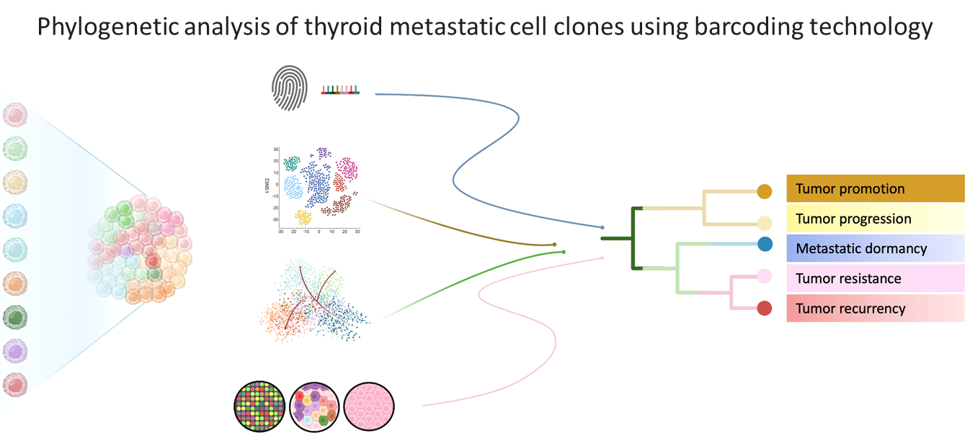
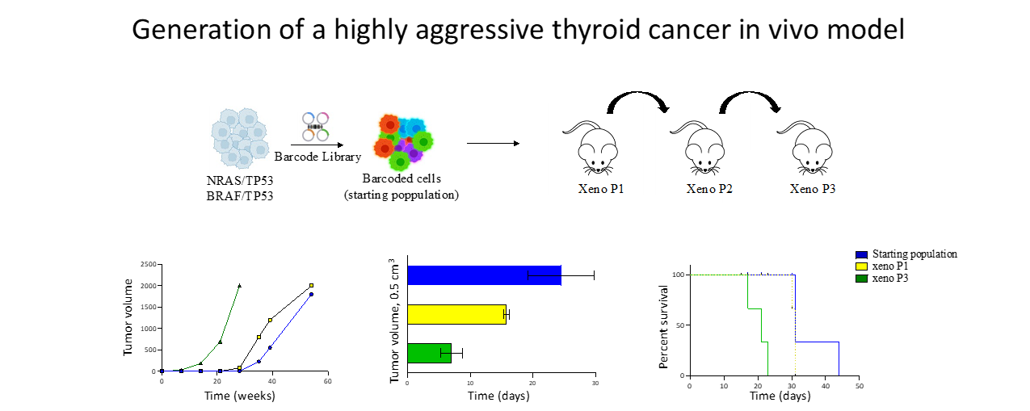
WP4: Preclinical models for precise therapeutic and diagnostic prevention strategies
Task 4.4: Generation and optimization of preclinical animal models based on the use of organoids (UNIPA: G. Stassi; IFO-IRE: F. Ganci, M. Porru; IOM: C. Colarossi; M. NEGRI: G. Damia; UniBO: L. Ricciardello)

Slide 21
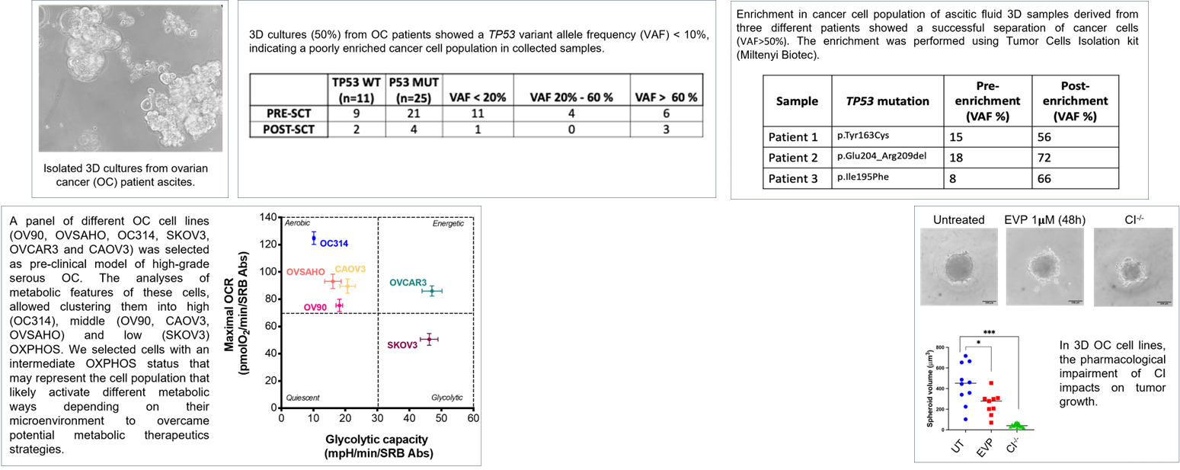
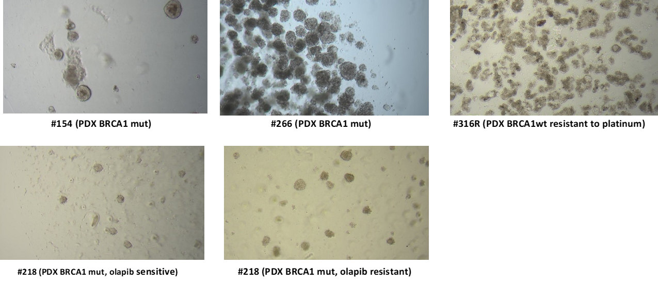
WP4: Preclinical models for precise therapeutic and diagnostic prevention strategies
Task 4.4: Generation and optimization of preclinical animal models based on the use of organoids (UNIPA: G. Stassi; IFO-IRE: F. Ganci, M. Porru; IOM: C. Colarossi; M. NEGRI: G. Damia; UniBO: L. Ricciardello)
We set up the experimental conditions to obtain organoids from patients derived tumor xenografts (PDXs) of ovarian carcinoma available to undergoing histological examinantion, validation of functional DNA repair assays (i.e. RAD51 foci basal levels), and to investigate the stability of the replication fork (i.e. fiber assay) to better understand tumor response to treatments.

Slide 22
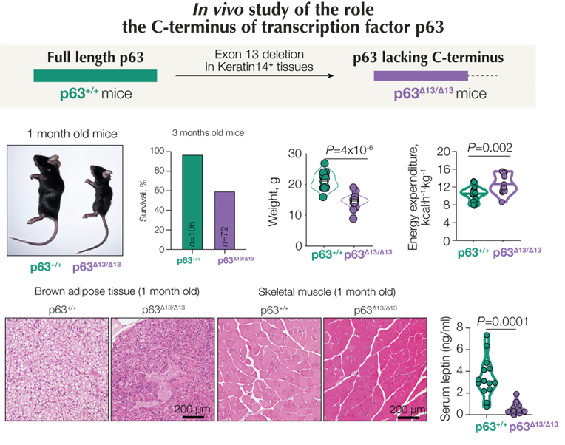
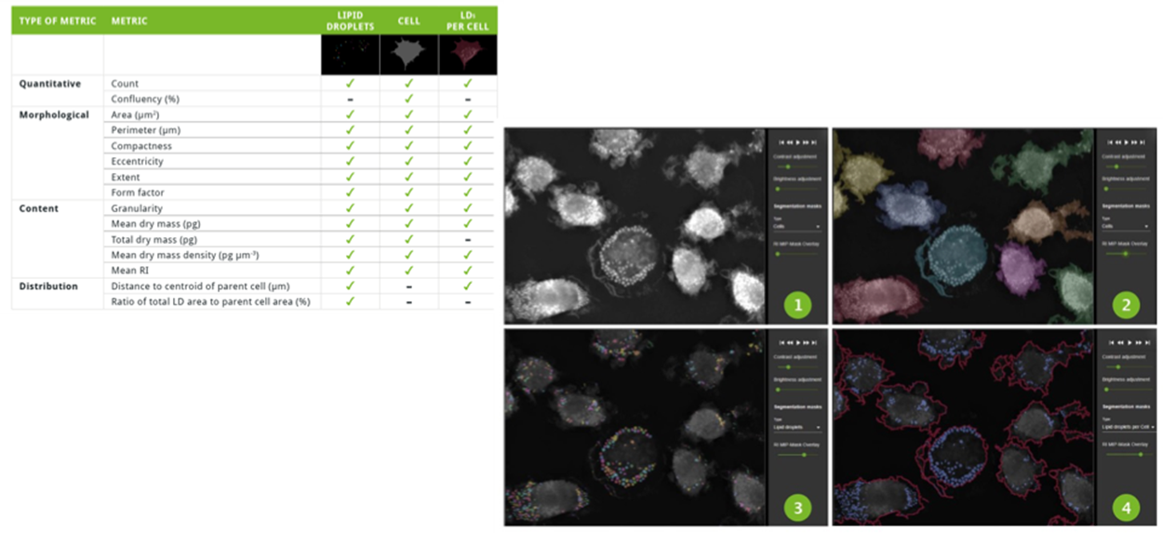
WP4: Preclinical models for precise therapeutic and diagnostic prevention strategies (UNIPA: G. Stassi)
Task 4.5: Mouse models of mitochondrial metabolism (UniTOR VERGATA: E. Candi, G. Melino; UniFG: T. Cassano; UniVPM: S. Marchi)
Lipid droplets (LDs) detection through a LABEL-FREE MODE using a 3D-Cell Explorer-fluo (Nanolive SA, and quantification with the smart lipid droplets assay software (Nanolive), which provided several metrics, including morphological parameters, distribution and content, to monitor and quantify LDs in live without staining

Slide 23
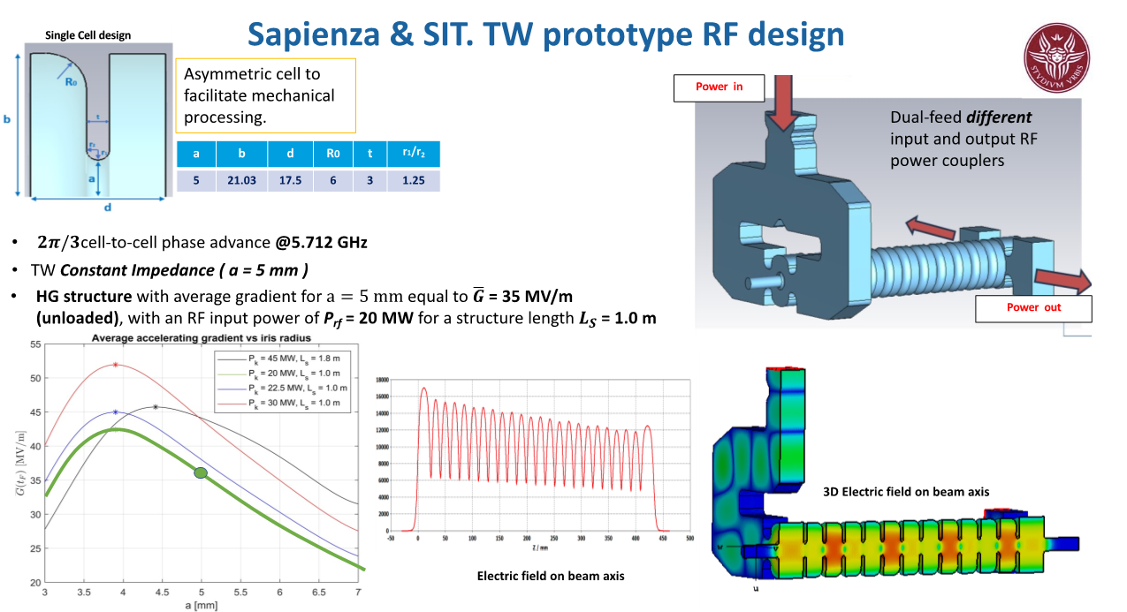
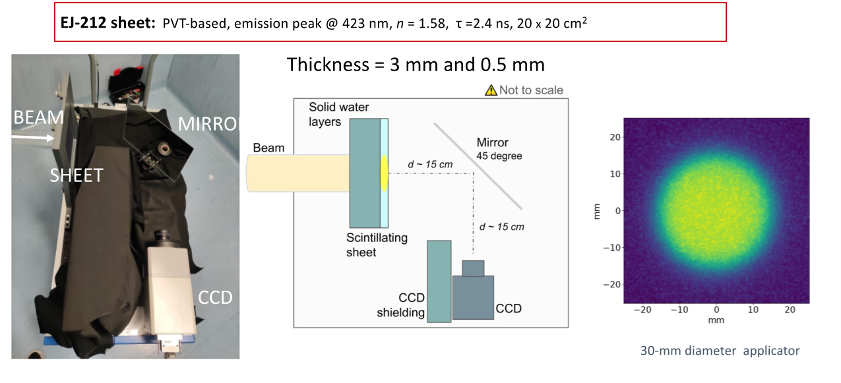
WP4: Preclinical models for precise therapeutic and diagnostic prevention strategies (UNIPA: G. Stassi)
Task 4.6: Innovative treatment planning system for electron FLASH radiotherapy from in silico modeling to preclinical validation in organoids and animal models for deep seated tumors (IOM: D. Giuffrida; UniROMA SAPIENZA: V. Patera; SIT: G. Felici; UniPI: F. Paiar, M. G. Bisogni)

Slide 24
Where are we going?
⁠Integration of Multi-Omics Data: Expanding the models to incorporate multi-omics data (genomics, proteomics, metabolomics, etc.) to enhance the accuracy and predictive power of the prognosis and therapeutic response;
Real-Time Data Analysis: Developing capabilities for real-time data analysis to provide timely prognostic and therapeutic insights, allowing for more dynamic and responsive patient care;
Personalized Medicine: Tailoring the prediction models to individual patients by including personalized health data, leading to more precise and effective treatment plans;
Machine Learning and AI Advancements: Leveraging the latest advancements in machine learning and artificial intelligence to improve model performance and uncover new predictive biomarkers.

Slide 25
The CHALLENGE
⁠Clinical Trials and Validation: Conducting extensive clinical trials to validate the models in diverse patient populations, ensuring their robustness and generalizability;
Collaboration with Healthcare Providers: Partnering with healthcare providers to integrate these predictive models into clinical workflows, facilitating their adoption and practical application in routine medical practice;
Ethical and Regulatory Considerations: Addressing ethical and regulatory issues associated with the use of advanced predictive models in healthcare, ensuring patient privacy and data security;
Educational Programs: Developing educational programs and tools to train healthcare professionals in the use and interpretation of these advanced prediction models, promoting widespread understanding and utilization.

Slide 26
Forecasts after project closure
⁠Enhanced Prognostic Accuracy: The development of sophisticated prediction models is expected to significantly improve the accuracy of prognostic assessments, enabling earlier and more reliable identification of disease outcomes;
⁠Optimized Therapeutic Responses: By predicting therapeutic responses with greater precision, the models will facilitate the customization of treatment plans, leading to more effective and targeted interventions for patients;
⁠Data-Driven Decision Making: Comprehensive data treatment will empower clinicians with robust, data-driven insights, enhancing decision-making processes in clinical settings;
⁠Reduced Healthcare Costs: Improved prognostic and therapeutic predictions will help in reducing unnecessary treatments and optimizing resource allocation, thereby lowering overall healthcare costs;
Patient-Centric Care: The integration of personalized data into prediction models will promote patient-centric care, offering tailored treatment options that align with individual patient profiles;
Scientific Advancements: The spoke 3 will contribute to the broader scientific understanding of disease mechanisms and treatment responses, paving the way for future research and innovation in the field of precision medicine;
Clinical Integration: The successful implementation of these models in clinical practice will bridge the gap between research and real-world application, ultimately improving patient outcomes on a large scale.

Slide 27


