Slide 1
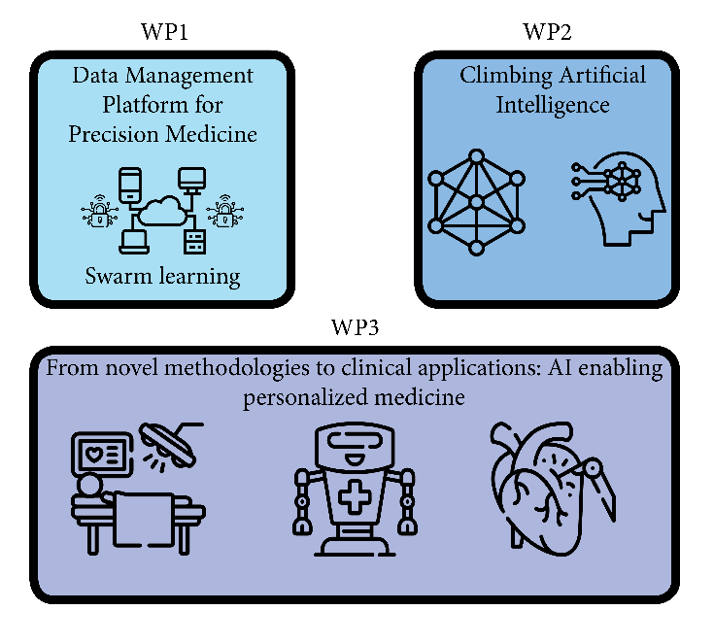
HEAL ITALIA Health Extended ALliance for Innovative Therapies, Advanced Lab-research and Integrated Approaches of Precision Medicine
Cascade call
SPOKE 2
Intelligent Health
University of Bologna
Cascade call – 12th December 2023

Slide 2
Context
Intelligent health, founded on large-scale data, aims to enhance precision medicine in diagnostics, interventions, personalized support, and healthcare services improvement
It is crucial to integrate electronic health records with imaging and high-throughput data. Such integration is key for unraveling disease heterogeneity, enhancing our molecular understanding of diseases, and pinpointing dimensional biomarkers
This objective inherently incorporates artificial intelligence (AI) techniques, which are progressively transforming biomedical research and healthcare landscapes. AI solutions depend on extensive training datasets and necessitate the development of reliable, swift, secure algorithms that safeguard confidentiality and privacy

Slide 3
Purpose of the Spoke
Intelligent health in healthcare
Under this cascading call, the goal is to amplify the development of industrial research and experimental activities aimed at creating personalized medicine pathways
Key areas of focus include:
Topic 1. Distributed AI training and testing through swarm learning
Topic 2. Generation and validation of synthetic data
Topic 3. Development of augmented reality systems that are integrated with robotic
surgery, employing an AI-based approach

Slide 4
Topic 1. Development of an open-source swarm learning framework for integrated and decentralized biomedical data processing
Context
The inherently decentralized nature of medicine results in a challenge: local data volumes are often too small to train reliable AI models. Centralizing data, meanwhile, raises significant privacy and confidentiality concerns
An open-source swarm learning framework could be the solution, allowing for the training of AI models without the need for local, dedicated servers. This framework would enable the sharing of model parameters through the swarm network and facilitate model building on private data at individual sites (swarm nodes)
By encouraging collaborative and interdisciplinary research, this initiative aims to apply swarm learning to multimodal biomedical data analysis, potentially transforming healthcare practices

Slide 5
Topic 1. Development of an open-source swarm learning framework for integrated and decentralized biomedical data processing
Expected outcomes
We are seeking innovative research and development proposals focused on creating technological solutions for an open-source swarm learning framework. Proposals under this topic should aim for delivering results that are directed, tailored towards, and contributing to all of the following expected outcomes:
Open-source framework development addressing large data sets and confidentiality: this framework must tackle the need for accessing large medical datasets while upholding the highest-grade encryption and confidentiality standards
Deployment and testing in a tri-institutional network: The developed framework needs to be deployed and rigorously tested within a network comprising at least three physical nodes (University of Bologna, University of Verona, and University Tor Vergata). Responsibilities of these nodes will include hardware provisioning, maintenance and technical support, and software setup and configuration.

Slide 6
Topic 1. Development of an open-source swarm learning framework for integrated and decentralized biomedical data processing
Additional specification
The framework's efficacy will be assessed through the training and validation of AI models. These models are to be developed for solving specific tasks using biomedical data. The data for these tasks will be sourced from open-access repositories, with specifics to be defined within the first two months of the project’s initiation

Slide 7
Topic 2. Advancing synthetic data in precision medicine
Context
The realm of precision medicine is on the cusp of a transformative leap, with deep learning at its core. However, the efficacy of these advanced models hinges on the availability of extensive datasets, a resource currently scarce in the medical field due to data privacy regulations
A promising solution lies in generative models capable of synthesizing realistic mono-modal and multi-modal synthetic datasets
This approach not only mitigates the data shortage but also alleviates the burden of manual data labeling for physicians, saving valuable time

Slide 8
Topic 2. Advancing synthetic data in precision medicine
Expected outcomes
We are seeking innovative research and development proposals centered on creating technological solutions and applications in synthetic data for precision medicine. Proposals under this topic should aim for delivering results that are directed, tailored towards and contributing to all of the following expected outcomes:
Generation of synthetic datasets: proposals should concentrate on enhancing the generation of both mono-modal and multi-modal synthetic datasets
Criteria for synthetic dataset quality evaluation: projects need to establish robust criteria for assessing the quality of synthetic datasets
Privacy preservation measurement criteria: it is essential for proposals to address the aspect of privacy in synthetic medical datasets
Ethical considerations and transparency: ethical considerations should be a cornerstone of the proposed methodologies

Slide 9
Topic 2. Advancing synthetic data in precision medicine
Additional specification
Adherence to common standards: proposals are encouraged to utilize common standards for healthcare data, metadata, communication, and interoperability, ensuring a harmonious and efficient integration into existing medical data ecosystems

Slide 10
Topic 3 – Developing AI techniques for augmented reality in robotic surgery
Context
This research topic aims to address the limitations of conventional 3D-guided robotic surgery, where a preoperative 3D virtual model is manually overlaid onto the surgical field
Currently, this preoperative virtual model is not automatically aligned with the actual organ during surgery, leading to potential errors due to manual alignment with the target anatomy. This could result in inaccurate dissection due to the limitations of non-automated augmented reality (AR)

Slide 11
Topic 3 – Developing AI techniques for augmented reality in robotic surgery
Expected outcomes
We are inviting proposals for innovative research and development projects focused on the creation of advanced artificial intelligence (AI) techniques for automated registration of 3D virtual models during robotic surgery. This includes the integration of AR to provide automatic surgical guidance to create a more dynamic, responsive, and interactive surgical environment.
Proposals under this topic should aim for delivering results that are directed, tailored towards and contributing to more than one of the following expected outcomes:
Enhanced creation of case-specific 3D virtual models through preoperative medical imaging
Advanced AI-based intraoperative registration. The AI system should also be designed to learn from each surgery, improving its accuracy and effectiveness over time
Comprehensive AR software based on preoperative imaging: the development of AR software should extend beyond mere real-time integration of the 3D model with the robotic camera

Slide 12
Topic 3 – Developing AI techniques for augmented reality in robotic surgery
Additional specification
Developed solutions should be compatible with the Hugo system by Medtronic, among others, and with tests on cadavers

Slide 13
BANDO A CASCATA SPOKE 2 - INTELLIGENT HEALTH
Dotazione finanziaria totale: 1.425.000 euro
Dotazione finanziaria per Soggetti localizzati nelle Regioni del Nord/Centro Italia: € 360.000,00;
Dotazione finanziaria per Soggetti localizzati nelle Regioni del Mezzogiorno:
€ 1.065.000,00
SCADENZA: 26/01/2024
È possibile presentare proposte in modalità «singola» o «collaborativa» (massimo 4 soggetti con sedi operative omogenee in termini di dotazione finanziaria)
https://bandi.unibo.it/altri-bandi/bandi-a-cascata-pnrr
https://bandi.unibo.it/PnrrBacHeal-Italia

Slide 14
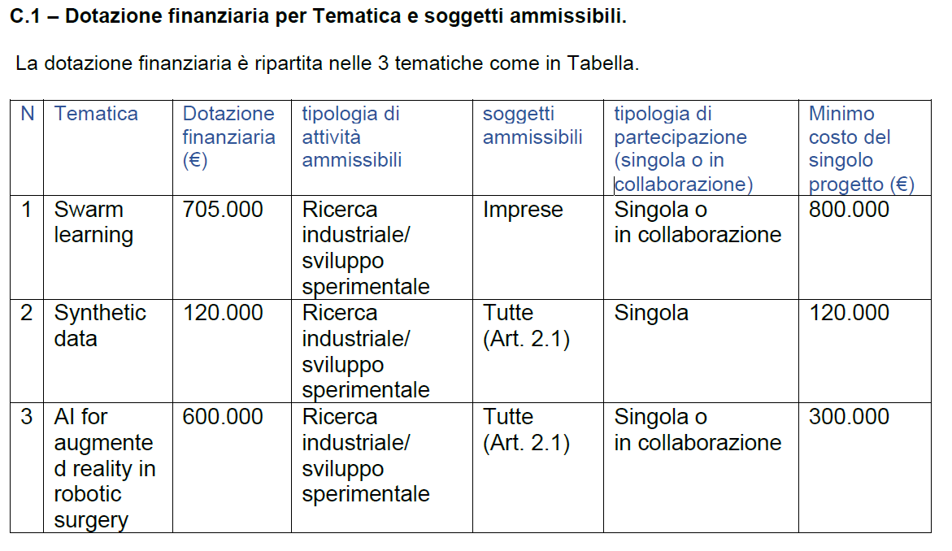
BANDO A CASCATA SPOKE 2 - INTELLIGENT HEALTH

Slide 15
Thank you
Cascade call – 12th December 2023

